Slide 1
Overcoming Common Challenges in the Measure Development Lifecycle
September 2021 MMS Information Session
Hosted by:
Brenna Rabel, Senior Scientist & Stakeholder Engagement Lead for the Measures Management System, Battelle
Guest presenters:
Dan Andersen, Director of Healthcare Analytics Services
Mike Sacca, VP of Health Informatics Services
RELI Group, Inc.

Slide 2
MMS Info Session Goals
Part of a larger effort to engage stakeholders and the public in quality measure development.
Additional activities the MMS team leads:
Annual public webinars on high-priority CMS topics
Outreach via our stakeholder listserv and
the CMS MMS listserv
MMS website updates and maintenance
Development and promotion of emerging
tools and resources
MACRA-specific education and outreach
Notes:
CMS is committed to providing Education and Outreach opportunities about the quality measure development process to interested stakeholders to improve understanding of the process. CMS also seeks continual feedback to improve and/or expand its offerings to the healthcare quality measure development community and interested stakeholders.
To date, CMS has implemented an Education and Outreach webinar series and has created resource materials that break down and explain various components and challenges in the measure development process. There are dedicated websites, listservs, and roadmap documents that are available to support those that are working in quality measure development, or are just curious and want to learn more about how it is done.

Slide 3
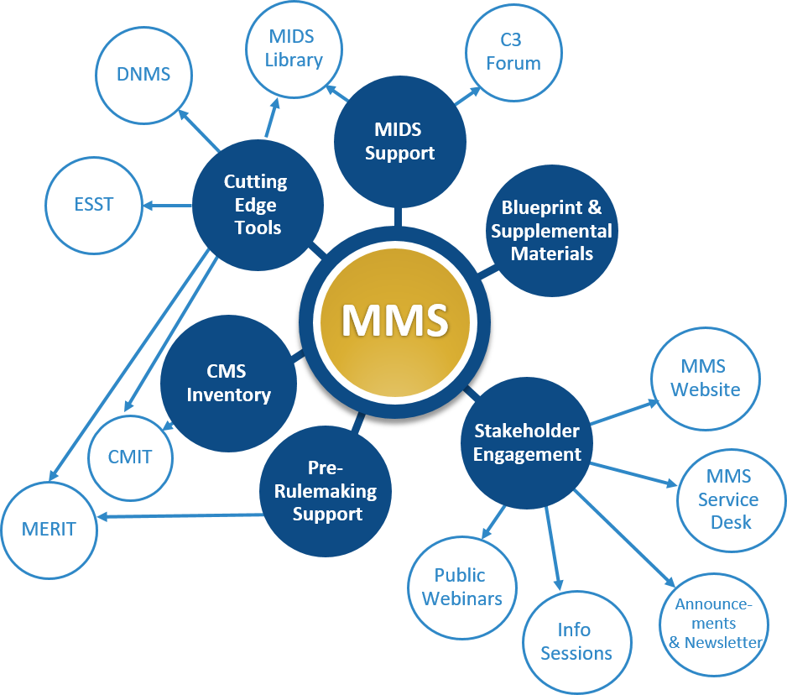
Measures Management System
CMS developed the MMS to foster and support standardization, flexibility, and innovation in quality measurement through a series of channels
RELI works with Battelle to support the MMS
Small business with experience as Measure and Instrument Development and Support (MIDS) IDIQ prime contractor, MACRA Cooperative Agreement Technical Assistance (CATA), and Post-acute Care Quality Reporting Program (PAC QRP) subcontractor
Notes:
Key components of the Measures Management System (MMS) include the creation of tools to assist in the development of quality measures, including CMIT, the MMS Blueprint, our website and a few tools which aide the task of environmental scanning, etc. The second key component highlights engaging stakeholders whereby we strive to engage a wide variety of stakeholders such as patients, clinicians, clinical specialty societies, patient advocacy programs, and measure developers on how to get involved in the CQM development process, or on how to refine their skills in that area.

Slide 4
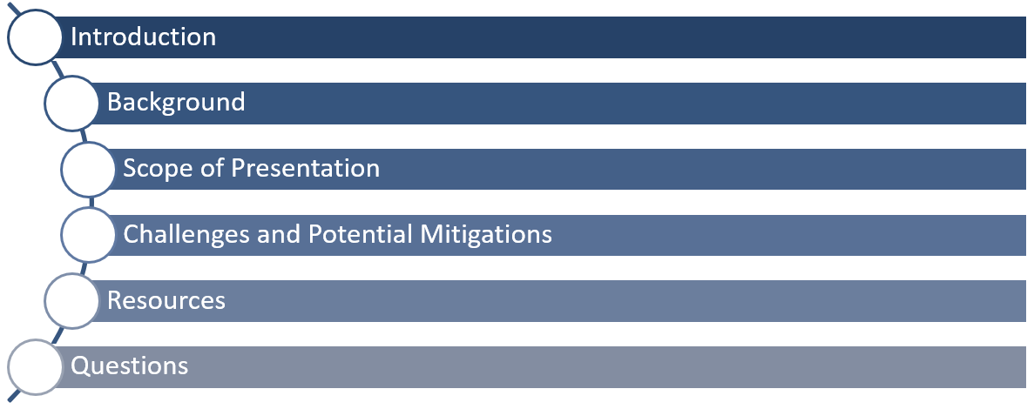
Agenda
Notes:
The RELI Group has many years of experience in measure development and reporting, employing SMEs with decades of experience leading largescale development efforts. Many challenges and mitigation strategies addressed in this slide deck are derived from direct experience, both in the public and private sector.

Slide 5
Background
Multitude of measure developers (e.g., CMS-contracted measure developers, specialty societies, and hybrid) and measure purposes (e.g., public reporting, value-based care, and quality improvement)
Challenges can arise for various reasons – data availability and quality, time and expense for testing, format of data (e.g., digital measures), and focus of measures (e.g., population health)
Lessons learned and best practices support all measure developers and compliment the available resources
Notes:
The RELI Group is funded by CMS to develop measures and follows a specific process as laid out in the MMS Blueprint and in accordance with contract statements of works and schedules. Many others develop measures outside of CMS programs, or at least without CMS programs as the main focus. There are specialty societies, associations and registries that develop measures, and hybrid situations where measures also get adopted into CMS programs.
What are the measures intended for?
Is it quality improvement specifically?
Is it for value-based purchasing programs or CMS public reporting transparency programs?
A big challenge and lesson learned is the need to align and monitor the project plan and timeline for key milestones and during the lifecycle, and also looking at external dependencies, constraints and timelines which vary depending on the intended measure’s purpose, the scope and use. Consideration is given to draft and final rule requirements, the NQF endorsement cycles and processes and other constraints. The focus of this presentation is on best practices with a goal of highlighting some next-level techniques in measure development. Lastly, sharing lessons learned from various measure development efforts with different perspectives help inform and drive these improvements and best practices.

Slide 6
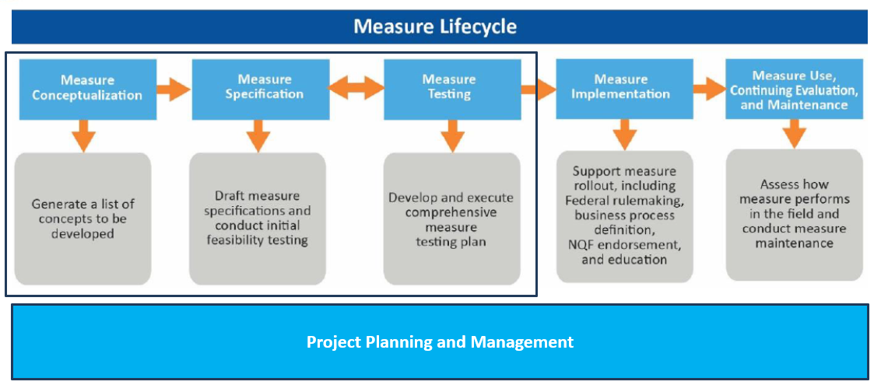
Scope of Presentation
Notes:
Here we focus on the earlier stages of the lifecycle from conceptualization through testing as depicted in this graphic. Addressed later are issues in the context of project planning and management, since these aspects of the development process underpin the entire process.
Notably missing here are bars you normally see on the bottom that cross lifecycle activities including feasibility, evaluation, information-gathering and stakeholder engagement. Here we purposely limit the scope to take a somewhat deeper dive into select key areas. The coming slides will transition to addressing project management, as well as general challenges outside of within the lifecycle’s specific stages.

Slide 7
Project Planning and Management
Measure development is complicated, with many constraints, competing timelines, and various stakeholders
Developers need to take the “long-view”
Understand external timelines, constraints, and dependencies (e.g., NQF reviews, CMS clearance, MUC list, and QPP timelines)
Effective communication, initially and on ongoing basis, with measure sponsors (e.g., CMS, specialty societies) and other stakeholders to ensure shared understanding of the project plan/timeline for EACH measure
Notes:
Take the long-view:
Consider methodology for end-to-end development, especially important for PRO-PMs or digital measures.
Ensure your project planning efforts build in the extended time needed for contingencies.
Reflect upon later phases of the lifecycle, such as implementation in the earlier stages such as conceptualization.
Constraints and timelines:
Often out of the measure developer’s control or purview.
May change from the time of award to start of measure development efforts.
Staying on top of external items and being in touch with various entities are of critical importance.
Additional consideration for eCQMs with evolving HL7 standards and requirements for technical specifications.
Consider EHR vendors and readiness to implement new or updated eCQMs.
In the case of CMS program-specifics such as MIPS within the broader context of QPP, maintain an understanding of the requirement of MIPS and CMS measurement priorities, which may evolve each year.
Other examples of external constraints involve the current evolving transition from the QDM CQL-based eCQMs to CQL QI-Core FHIR-based eCQMs.

Slide 8
Project Planning and Management (cont.)
Varying measure types will have different planning and management needs
Project plan must acknowledge additional considerations for certain measure types (e.g., PRO-PMs and eCQMs )
Best practice for creating the project plan includes entire lifecycle (from conceptualization to use) to ensure an understanding of how data will be collected, calculated, and used, considering responsible parties and stakeholders
Notes:
Apply an eyes-wide-open approach and consider the likelihood of a longer development lifecycle.
Stress open communication early and often during planning to mitigate challenges down the road.
Project plans should include data identification, assessment, cleaning, analysis and implementation throughout the entire lifecycle and requires prospective test data once the workflow or technical changes are made.
Leverage health IT vendors and clinical facility or practice sites to support the testing phases, and the project plan needs to include timelines for vendors and measure calculators that have internal timelines, dependencies and approvals.

Slide 9
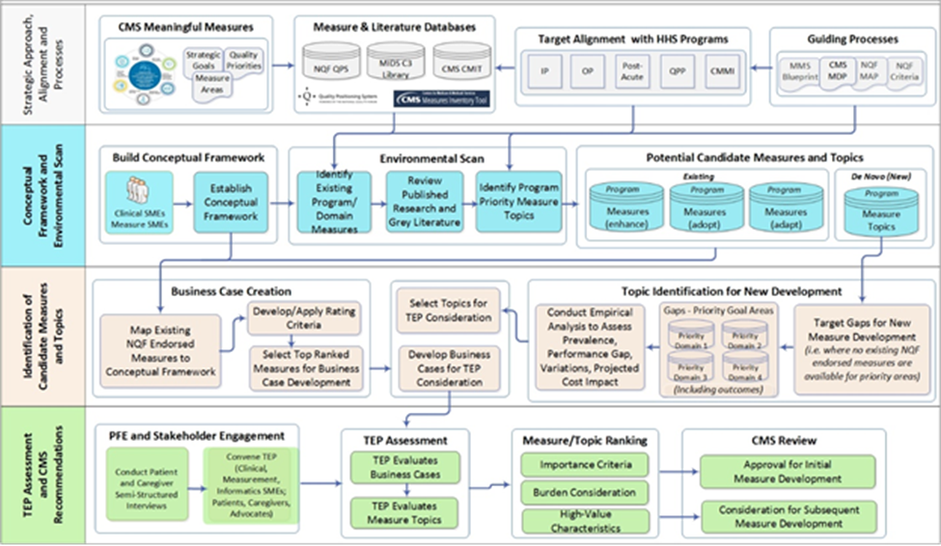
Project Planning and Management (cont.)
Notes:
This graphic is not intended to be prescriptive, but instead to lay out from a measure conceptualization point of view the different phases whereby you may visualize this process via a Visio or a swimlane type of approach.
At a high level, what’s your strategic approach?
What’s your endgame?
What are the driving precursor documents and artifacts driving your development efforts?
From a CMS measure developer perspective, this is the Meaningful Measures Initiative 2.0. Here we reference measure and literature review databases or tools — NQF’s quality positioning system, CMS Measures Inventory, the MIDS Library.
Conceptual framework:
What is your target for settings or programs or clinical care areas? Disease-specific or condition-specific areas?
What are the tools, the guiding processes that revolve around that?
In thinking about NQF consensus-based endorsement, what is required up front? NQF criteria, etc.?
The Blueprint and NQF MAP —what are they saying? What’s the trend and the sense there on those matters?
What are the high-value characteristics being attempted to attain for measures?
How do they fit into this framework?
Business case creation—Here it’s crucial to develop a business case and review the characteristics of the measure against some defined framework of characteristics and apply a ranking or a rating.
What’s the bang for the buck for this measure?
What’s the performance gap? How big is it?
Where are identified burdens?
Stakeholder engagement—With the express goal of building measures to drive improvements in the quality of care, here you engage patients, caregivers early and often, as well as your clinical and domain experts as part of your TEP.
After business case review and gaining different perspectives on this issue, what has buy-in?
Which areas require a step back to revisit strengthening XYZ?

Slide 10
Practical Considerations
Development efforts are often challenged by unrealistic expectations from the start
Be pragmatic when developing measures – This includes when considering the number of measures and the complexity of the measure(s)
Like with any good project management, avoid “boil the ocean” approaches
Clearly understand and transparently share the estimated resources required to effectively include others, such as EHR vendors and data repositories (discussed later in more detail)
Consider dividing development into measure building blocks
Notes:
Strike a balance between being forward-thinking and innovative but not omitting the underlying realistic expectations, with an ultimate goal to develop measures as quickly as possible and to shorten the development lifecycle.
Complex measures:
Workflow or technical challenges should be considered early in the development process, or even during funding.
When considering the associated feasibility challenges, stress the goal of “filling a gap.”
With clinical or technical workflow challenges acknowledge and communicate them early; hold discussions with experts, your TEPs, your funder, your caregivers and families and patients.
Boil the ocean approach—Can you scale down to a smaller set of high-value, high-impact measures with a realistic timeline that acknowledges constraints?
Measure building blocks:
Divide your development process into two phases, the first being measure establishment.
Avoid overreaching assuming completion of a full-blown PRO-PM with no intermediate outcome.
Make small incremental gains and build as more data becomes available through the already established process and whatever workflow was required, which may land you in a better position to transition to an outcome-driven measure.

Slide 11
Conceptualization Phase
Measure developers, stewards, and sponsors don’t always realize a return on investment
Early buy-in from stakeholders and regular touch points
Fail early, not often - Initial analysis on feasibility and other potential challenges
Notes:
The ultimate goal is to create measures that make an impact, and that impact needs to be measured by some ROI, by being that value-add piece — to the patient, to the provider and to the funder — which can go beyond dollars and cents.
Can we take some lessons learned and translate that going forward?
Were there external constraints we didn’t realize at the time of the award or the start that we can learn from?
It’s especially important when tackling a significant measure or specialty gap/subspecialty gap area. The question of ROI and the definition of success vs. failure becomes blurred. Consider the expectations at the start and any constraints, unknowns and roadblocks. This is your qualitative/quantitative assessment of the ROI. To “fail” in terms of measure development speak, do so early enough thereby shifting the workflow and gaining the feasibility that is required There may be cases where something is not feasible currently, but implementable moderate changes can make it worthwhile.
Do you throw the baby out with the bath water, because the current state feasibility isn’t there, or do you work for the broader, longer-term goal?

Slide 12
Conceptualization Phase (cont.)
Measures need to fill real measurement gaps
Determine measure’s alignment with meaningful measures
Comprehensive scan of existing/competing measures
Leverage available resources and tools
Revisit regularly and comprehensively
Clear articulation of why proposed measure is improvement, complementary, or otherwise necessary
Notes:
Example:
The RELI Group created new measures for an existing quality rating system. They created a framework where they mapped the existing measures in the program to the Meaningful Measures categories, thereby visually determining the gaps that could be filled by either adapted or de novo measures. This was helpful not only for the RELI project team, but the stakeholders and TEPs so they can see concretely where to focus their development efforts and provide guidance.
Environmental scan:
Aim to be comprehensive and identify potentially competing measures early.
Take a deep dive “thinking out of the box” using all the tools available at your disposal.
As a best practice, communication, cooperation and transparency across measure developers is essential to success through conversations and sharing information openly to help identify measures that other contractors or developers have under consideration, and not relying simply on the published or public domain.
Lastly, with regards to conceptualization, it’s imperative that developers articulate early in the process the potential impacts of their measures in terms of costs, lives saved, etc. You may reference the business case template tool to help frame the measures as well as the gaps being filled.

Slide 13
Conceptualization Phase (cont.)
Quality measures should support quality improvement even if that is not explicit intent
Emphasize digital measures
Consider how information should be displayed for patients (e.g., via patient portals) and providers and how information should be communicated between providers
Notes:
Most of this audience is likely aware of the push by the government for digital measures which proposes an ambitious and aggressive timeline that now anticipates the CMS measurement portfolio to be digitized by 2025.
What do we mean when we say digital quality measures (dQMs)? What are they in terms of a definition?
It’s part of the Meaningful Measures 2.0 Initiative defined by CMS. It’s defined as measures which originate from sources of health information that as the name implies are captured and can be transmitted electronically and via interoperable systems.
NCQA Report: This report released this year recommends CMS continue its push for dQMs to eliminate redundancy in implementation and reporting, both stressing the future state of “capture the data once and report it multiple times” instead of where we are today, “capture the same concept for one program, two programs, three programs and report it three different times or three varying sets of requirements.” NCQA’s report further applauds the 2025 timeline and provides their example of a definition of a digital measure as one derived from digital resources such as EHRs, Health Information Exchanges and clinical registries. We’re essentially stating that at some point in time by 2025 it’s more plug-and-play, less manual and more automated work through these other data sources.
A big driver of the push for dQMs will continue to be the use of evolving HL7 standards and FHIR, including the future state of eCQMs or dQMs from a CMS perspective and the associated APIs to allow clinicians and facilities to submit information one time, but being used in many ways.
Digital measures and the relationship to better care coordination and quality improvement at the point of care and the better communication between providers — it can all flow from that as opposed to standard claims-based measures.
NQF Report: This report is around leveraging EHR-sourced measures to improve care coordination and communication, which also includes examples that may prove helpful. How can I better get from measures that really drive quality improvement, drive improved communication and communication between providers, patients, clinicians, et cetera?

Slide 14
Specification Phase
Developers struggle to align and adapt similar or competing measures
Developers must work together, even when they are working on separately funded contracts/efforts to ensure the best measures are put forward and to reduce burden
Collaboration is required when adapting measures
Notes:
Example:
Before RELI, we were developing measures for qualified health plans and discovered that with our subcontractor we were developing a measure of adverse drug events for diabetic patients that was being pursued by a third entity. We had a good working relationship between the three entities and received approval from CMS and determined the best course forward would be if the three of us developed the measure in partnership. We could then leverage the dataset that each group had, as well as tap into the various stakeholder perspectives.
We worked with NQF to identify potential hurdles with the endorsement process. Once those challenges were worked out, we created an MOU to ensure that all entities were in agreement, protected and on the same page. Due to the nature of developing measures in known high-priority gap areas, the odds of this scenario increase. Ensure that proper channels are utilized such as consulting with CMS or your particular funder. It may be just blessings from within your organization and asking for legal advice. So for this example, we had CMS and NQF as partners, and it was critical to ensuring our success.

Slide 15
Specification Phase (cont.)
Specific to digital measures, standards workgroups have their own timelines that are not necessarily aligned with measure developers’ project plans
Use the eCQI resource center and track the work of the standards groups (e.g., HL7) from the start of the project
Ensure timelines for eCQM testing includes completion of the NQF Feasibility Scorecard during the first year of the project to identify issues early in the measure development process
Include assessment of electronic/clinical workflow that may be needed for measure data collection/reporting.
Notes:
Constraints and timelines are often outside the control of the measure developer, and in digital measures especially there’s an active ecosystem of people creating and adapting standards. While exciting as all of these collective efforts get us closer to interoperable data and better measurement, the timelines don’t always necessarily align with developers.
We recommend that all developers — especially those developing digital measures — be active users of the eCQI Resource Center, as well as following HL7 activities, especially the relevant or applicable standards workgroup. This provides a better understanding of anticipated standards, or adoptions or upcoming changes.
We acknowledge that going through and filling out the Feasibility Scorecard in the first year might be unrealistic, unless you have good quality data available, the feasibility assessment should start early and continue throughout those early discussions and considerations of what is the current state vs. the state needed to support the measure.

Slide 16
Specification Phase (cont.)
Measure developers struggle with risk adjustment and stratification
Consider the empirical vs. conceptual/practical need for risk adjustment as well as for including specific variables in a risk adjustment model
Carefully consider and test whether stratification is a preferred alternative to risk adjustment
Include stakeholders throughout the process
Keep current with state-of-the-science (e.g., Blueprint revisions and supplements and NQF reports, like the 2021 Social Risk Trial Final Report)
Notes:
Is risk adjustment necessary?
Developers should think critically about a measure’s ultimate goal. If intended for a P4P program, risk adjustment may be more favorable than for public reporting or transparency purposes alone. Hybrid approaches can be considered, discussed in the risk adjustment supplement to the Blueprint. Another consideration is the risk of explaining away important quality issues. For example, just because a socially disadvantaged group has demonstrably or historically worse outcomes, that may not in itself warrant risk adjustment. It may instead obscure issues at the provider level while not addressing root causes.
Consideration on a case-by-case basis with stakeholder input, statistics and discussions with CMS and funders, while being balanced and remaining true to program goals.
Conceptual models are useful and may explain and examine the causal pathway to outcomes.
A conceptual model may inform which variables should be included in a risk adjustment model, an approach looking at which variables are statistically significantly associated with the outcome.
Example:
A benefit of stratification is that it gives audiences more information. A patient may be interested in drilling down to determine performance of a provider related to people who are like them on variables. It may be obscured by risk adjustment models, and so that can be worth considering. Similarly stratification can assist in the quality improvement context to help drill down and determine if there are pockets of the population that you need to do a better job.
Example:
Developers should consistently reexamine the operationalization of risk adjustment models in variables. Age is a variable used often in risk adjustment models, but consider other variables that get at biological age and issues of frailty — biological age vs. chronological age. This may be considered and tested to determine if it could provide more precision if our interest lies in looking at age as identifying underlying risks in the models.

Slide 17
Specification Phase (cont.)
Imperfect tools and data to account for social determinants of health or to address equity
HP 2030 goal to “create social, physical, and economic environments that promote attaining the full potential for health and well-being for all.” Measurement goals should be aligned to this goal
Consider how measures can improve equity even if equity is not the focus
Ensure the measure data can be used at individual, provider, and population-levels to help plan for and improve public health/pop health services
Coordinate with social services providers to identify data nuances that measure developers may help with.
Think creatively about data quality and availability. Stay current with promising developments to standardize data elements (e.g., the HL7 Gravity project)
Get involved
Notes:
Measures can play a crucial part in meeting the Healthy People 2030 goal to address equity, and so measure developers can consider the next level measurement development techniques to have these ideas in mind.
Consider measure data used at the individual provider and population levels down the road.
Coordinate with social service providers to identify any data nuances; if a measure developer is between two data sources in working with social service providers, decide to opt for the one best known or used by the providers.

Slide 18
Testing Phase
Lack of data for testing
Developers must include in plans enough time to recruit sites, onboard sites, implement workflow changes, and collect or obtain access to necessary data to test the measures
Highlights need for creating or leveraging relationships with other stakeholders (vendors or data groups)
Clear understanding of associated costs and transparency with prospective test sites and vendors
Notes:
Where do I get the data?
Who will work with me?
EHR vendors, HIT vendors, clinical practice sites, or facilities?
Propose transparency with prospective test sites and vendors by entering into agreements as part of your initial proposal. You may encounter better results from the beginning if they also have “skin in the game.” Of course, there are budgetary implications which highlights the need for leveraging these stakeholders and associated relationships.

Slide 19
Testing Phase (cont.)
Prospective data collection
Early engagement with implementers
Phased approach – e.g., building the PRO first or determining the best PRO to include in the program
Be explicit about intended use
Additional mitigations

Slide 20
Resources for Measure Developers
MMS Blueprint, supplemental materials, and templates (link to site)
Tools and resources (link to site)
CMS Quality Measures website (link to site)
National Quality Forum (link to site)

Slide 21
Questions

Slide 22
On September 10: Blueprint Version 17!
On Friday, September 10, 2021, the Centers for Medicare & Medicaid Services (CMS) published the updated Blueprint for the CMS Measures Management System on the Measures Management System website.
Highlights of the changes for Version 17 include
A new supplemental material addressing the topic of population health measures
Substantially revised Business Case Form & Instructions and related content
Additional information on special considerations for Medicaid-focused measures
Significantly revised reliability content
Information about the new CMS Measures Under Consideration Entry/Review Information Tool (CMS MERIT)

Slide 23
Announcements
In case you missed it:
August Info Session “Specifying Your Measure: How to create clear and unambiguous measure specifications” now available on YouTube https://www.youtube.com/watch?v=Dat1vvWqJYA
Upcoming Info Session
October 27th from 2:00 – 3:00pm ET on the MMS Blueprint new supplemental material addressing the topic of population health measure

Slide 24
Final Slide with Battelle & CMS Contact Information
Battelle
Brenna Rabel (Stakeholder Engagement Task Lead)
Contact: rabel@battelle.org
Feedback: MMSSupport@battelle.org
CMS
Mike Brea (CMS Project Lead)
Contact: michael.brea@cms.hhs.gov

