Slide 1
Maximizing Efficiency of Information Gathering with the De Novo Measure Scan (DNMS) Meridith Eastman | Battelle Amy Leibrand | Battelle
3/17/2022

Slide 2
Presentation Overview
Information Gathering Review
Environmental Scan Support Tool (ESST) Review & Demo
De Novo Measure Scan (DNMS) Tool Demo
Questions
Notes:
This webinar will discuss information gathering as to what it is and why we do it, and then the steps entailed in the measure lifecycle. Also discussed will be typical approaches to environmental scans and their drawbacks. Lastly, a review and demonstration of two tools that Battelle has developed for CMS to support efficient information gathering — the Environmental Scan Support Tool (ESST) and the De Novo Measure Scan (DNMS) tool.

Slide 3
Info Gathering in the Measure Lifecycle
Notes:
Information gathering falls under the conceptualization stage which encompasses researching a variety of sources, conducting a gap analysis, developing a business case and engaging multiple stakeholders. The end goal of measure conceptualization is a meaningful and well-researched measure concept with well-defined initial components.
Lastly, while information gathering is shown here under conceptualization, it can be conducted at other stages in the measure lifecycle, such as during measure respecification and reevaluation.

Slide 4
Defining Info Gathering
Systematic and comprehensive gathering of information that results in knowledge base about a measure, including:
Quality goals
Strengths and weaknesses of pertinent scientific evidence
Foundation of business case (i.e., anticipated impacts and outcomes)
Evidence of general agreement or conflicting views on quality issues
Awareness of prior pertinent measure development work
Notes:
Information gathering refers to all of the information a measure developer can glean about a measure prior to the testing phases, a time to assess whether there are any similar measures already in existence. It also helps to determine what impacts such a measure might have on the quality of care being delivered for a condition.

Slide 5
Why Conduct Info Gathering?
Supports identification of appropriate priority measurement areas
Ensures that measure development, respecification, and/or reevaluation builds on a body of evidence and relevant prior work
Bring forward lessons learned about feasibility or scientific evidence
Identify potential unintended negative consequences
Notes:
Information gathering supports the submission requirements of NQF, the consensus-based entity, and provides the knowledge base for business case development and strongly influences the subsequent steps in development by identifying the quality gaps that the measure is intended to fill. By executing these steps of information gathering early on, developers learn whether the concept is truly worth investing additionally efforts.

Slide 6
Info Gathering Activities
Identify healthcare quality issue and its priority area
Conduct an environmental scan
Analyze empirical data (when available)
Evaluate information collected during environmental scan and data analysis
Conduct measurement gap analysis
Justify new measure creation
Apply measure evaluation criteria
List of measures or measure topics for development
Notes:
Eight steps comprise information gathering, which may not occur sequentially.
Identify healthcare quality issues and its priority areas:
Defines the scope and focus of the measure and its relation to healthcare needs and quality improvement. In addition, it’s important to consider top volume and top cost conditions as areas of measure focus.
Conduct an environmental scan:
Includes a review and evaluation of the peer-reviewed and grey literature, the clinical practice guidelines, the relevant legislation and regulations and the existing related and competing measures, empirical data and expert and stakeholder input.
Critical to the identification of related or competing measures and may identify opportunities for consolidation or alignment between measures.
Identify clinical guidelines relevant to the topic
Identify studies having used similar measures in similar settings or populations.
*Box in red: Discussed further during ESST portion of presentation.
Analyze empirical data:
Analyze statistical data on incidence or prevalence to identify notable gaps or variations in care. Data provides evidence to support inclusion/exclusion for various populations.
Analyze ROI data to support the development of the business case.
Analysis of empirical data can identify the feasibility and data availability concerns early on in the measure development.
Evaluate information collected during environmental scan and data analysis:
Example: If a related measure is identified through an environmental scan, consider how the initial measure concept is differentiated from the related measure. Measure may be respecified for a different population, setting or data source.
Conduct measurement gap analysis:
Identify what’s missing from the measure focus or topic; critical for the identification of the related or competing measures.
*Box in red: Discussed further during DNMS demo.
Justify new measure creation:
Considerations for the justification of a new measure will vary by measure type, but include the development of a solid rationale or the identification of evidence that the measure is linked to a desired health outcome.
Apply measure evaluation criteria:
For importance consider the measure’s potential impact on costs and gaps in care and whether the measure can help translate clinical guidelines into meaningful measures.
For feasibility consider the potential data sources.
Other measure evaluation criteria such as scientific acceptability and usability are more pertinent at later stages of the measure development.
List of measures/measure topics for development:
Informed by the results of all of the previous steps and potentially includes respecified new measures or measure concepts.
The resulting list will include measures and measure topics appropriately aligned or differentiated from existing measures.

Slide 7
Typical Environmental Scan Approaches
Manual searches using keywords or phrases to scan databases and search engines for information about existing measures, current guidelines, and other relevant literature
Limitations:
Time consuming and resource intensive
Requires precise search parameters (e.g., correct keywords/phrases, time period, sources)
Requires resources to search multiple databases, evaluate and cull results based on relevance

Slide 8
CMS Info Gathering Tools
CMS has developed two tools to support efficient Info Gathering, available to the public on the CMIT platform
Environmental Scan Support Tool (ESST)
De Novo Measure Scan (DNMS) Tool
Both use artificial intelligence to find and identify the most relevant information related to measure concepts

Slide 9
Environmental Scan Support Tool (ESST)
Notes:
The Environmental Scan Support Tool (ESST) is available on both the public CMIT site and the Expanded Access CMIT site that requires a login. The only difference is the additional functionality on the expanded site, but the ESST case and results for CMIT measures are the same on both sites.

Slide 10
Environmental Scan Support Tool (ESST)
Current, accessible index of the top 30 most relevant abstracts and articles in PubMed, PubMed Central, and CINAHL for quality measures found in CMIT
2007 to present
Output updated monthly
Exportable output
Links to source documents
Notes:
ESST provides a prioritized list of the most relevant top 30 abstracts and articles specific to measures in the CMIT Inventory. ESST offers a variety of features, including hyperlinks to source documents and export features to Excel, or as an RIS bibliographic citation file.

Slide 11
De Novo Measure Scan (DNMS)
Notes:
Results in ESST for a CMIT measure are specific to that measure. It is a static list updated monthly, whereas DNMS is a dynamic tool that generates scan results based on user input.

Slide 12
De Novo Measure Scan (DNMS)
De Novo Measure Scan is a feature of the Environmental Scan Support Tool (ESST) on Expanded Access CMIT
Uses structured search terms pre-identified from Clinical Quality Measure (CQM) concepts, that mirror the structure of a measure, and reduce time needed to run a scan
Identifies and prioritizes most relevant PubMed, PubMed Central, and CINAHL content, simultaneously searching multiple engines
Notes:
In Expanded Access CMIT, the user selects search terms from a list of CQM concepts that mirror the structure of a measure to create a new measure description with the search terms, and then it returns the most relevant literature related to that query. Both the ESST and DNMS pull content and use similar artificial intelligence (AI) and machine learning algorithms to identify and prioritize the most relevant literature related to the measure concepts.

Slide 13
De Novo Measure Scan Uses
De Novo Measure Scan is useful for:
Measure developers
Gathering biomedical literature at the start of the measure development process that is directly pertinent to the measure concept
Gather up-to-date support needed to justify the respecification of an existing measure
CMS
Assess the robustness of information gathering for candidate measures during the vetting process
Improves efficiency and effectiveness of reviews and information gathering
Notes:
CMS may use the DNMS as a collaboration tool to provide useful feedback to measure developers during the information-gathering process.

Slide 14
ESST and DNMS Uses
Notes:
Both ESST and DNMS may be used together to justify the respecification of an existing CMIT measure. A developer can check the ESST for the measure to get the most recent scan data and then compare the ESST results with the preceding scan for that measure — the evidence cited in the measure information form (MIF) to identify any gap areas that need further support to justify the respecification of that measure.
The ESST enables a user to narrow the focus of additional information gathering to themes in need of more evidence. In DNMS, the developer can run a scan using search terms specific to the gap areas of interest to identify additional support needed to justify respecification.

Slide 15
How De Novo Measure Scan Works
Quality measure concepts are represented by a Clinical Quality Measure (CQM) ontology that “describes” a measure
Target population
Health status or utilization
Change concept
Expected output
Care setting
Structured search terms represent CQM concepts to “build” a new measure
Artificial intelligence (AI) identifies and prioritizes the most relevant PubMed, PubMed Central and CINAHL content related to queried CQM concepts
Notes:
DNMS and ESST employ a relations search in which the system uses concepts and relationships to find relevant documents with similar concepts and relations, whereas a keyword search is only searching concepts, which can result in false-positives in your results thereby providing a higher precision in recall than a keyword search, which makes the scan process much more efficient.

Slide 16
CMS Measures Inventory Tool (CMIT)
A searchable repository of measure information
Provides functionality for measure comparison, review and environmental scans
2 versions of CMIT: (1) Expanded Access, (2) Public
An expanded access account can be requested from CMIT
Expanded Access | Public
https://cmitmms.cms.gov | https://cmit.cms.gov
Login credentials and 2 factor authentication required | No login or authentication required
Access to Environmental Scan Support Tool (enhanced functionality) | Access to Environmental Scan Support Tool (limited functionality)
Access to De Novo Measure Scan | No access to De Novo Measure Scan
Notes:
The De Novo Measure Scan (DNMS) is available on the Expanded Access version of CMIT which requires a login. The Expanded Access CMIT also includes the enhanced version of ESST; although, a more limited version of ESST is available on the public CMIT site as well, the results for the ESST on both sites are the same.

Slide 17
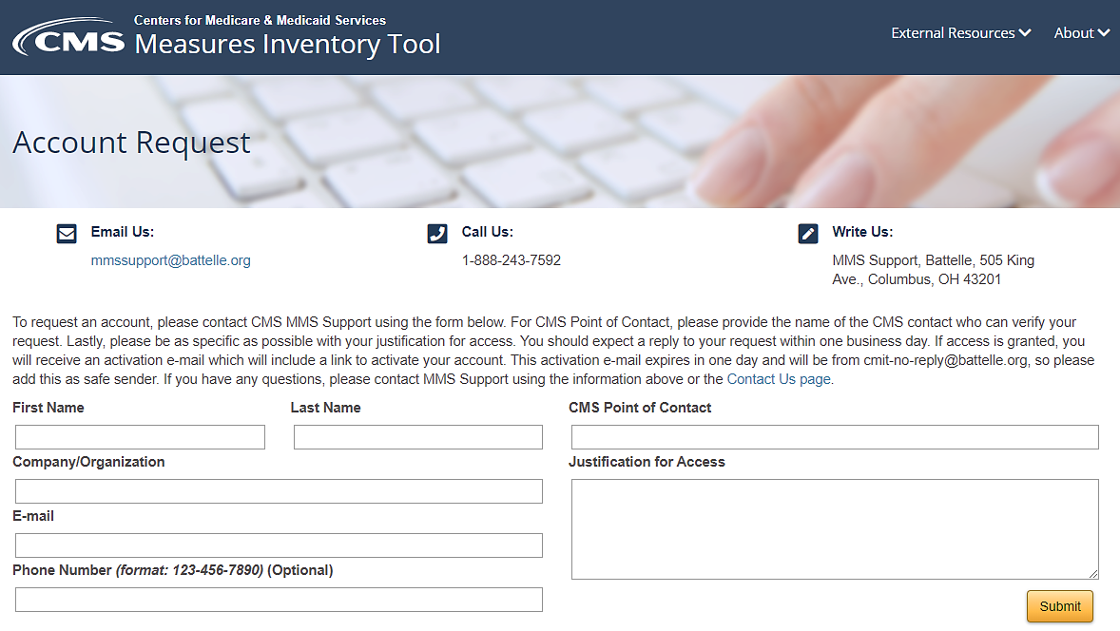
Accessing Expanded Access CMIT
Request a CMIT account at https://cmitmms.cms.gov/CMIT/ViewAccountRequest

Slide 18
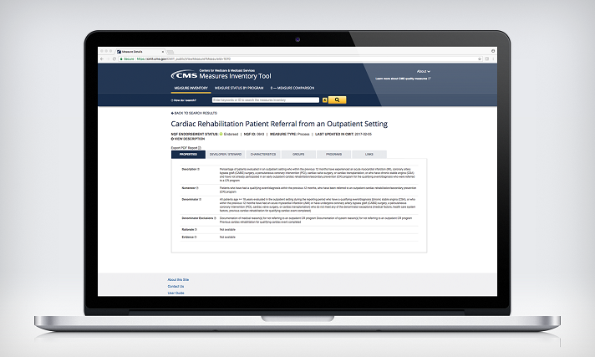
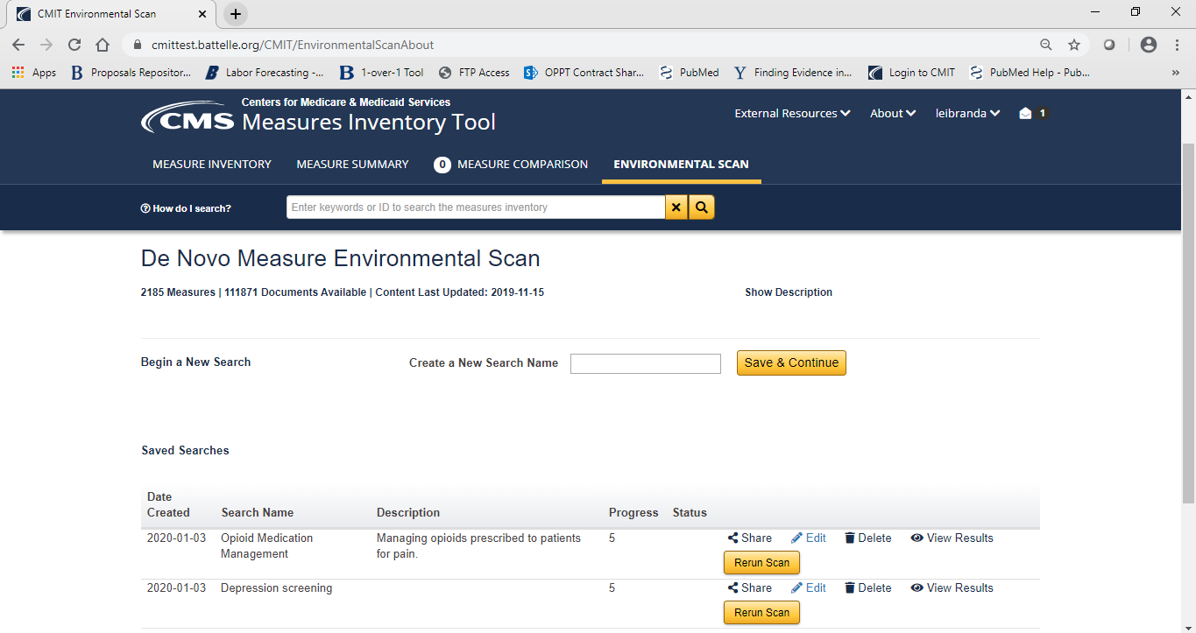
Demo
https://cmitmms.cms.gov – Expanded Access CMIT (account required)
Notes:
De Novo Measure Scan (DNMS) demo
CMIT homepage:
Displays tabs for measures inventory, measure summary, environmental scan. etc. This tool is freely available to all CMIT accountholders and anyone can apply for a CMIT account.
Measure inventory tab:
Contains all measures in the CMIT Inventory. Clicking on “measure title” contains details and information associated with that measure, including the environmental scan.
Environmental scan page:
This demo example is the “30-day unplanned readmissions for cancer patients” measure. Contains the top 30 abstracts and articles updated monthly from PubMed, PubMed Central and CINAHL. Contains citations from the MIF noted by the source called “EndNote.”
QuickStart Guide:
DNMS homepage QuickStart Guide contains accordion drop-downs with brief descriptions of its functionality.
New search:
Example: “Opioid medications management.” Click save and continue, which opens a new page where we select search settings, properties and characteristics.
Under the search mode choose to search only citations, only full-text articles or both. Search name is auto-populated from the previous page. Add an optional description for the new measure. Select the desired maximum number of search results displayed.
New measure properties and characteristics:
Represent the components of a MIF and include the denominator, numerator and change concepts. The denominator is the preexisting state prior to the change concept. The numerator is the health state or healthcare service that is more or less likely to occur due to the experience of the change concept. The change concept is the healthcare behavior intending to change the likelihood of the numerator.
For demo select hypothetical measure “medication management for adults using opioids for pain.” The health status denominator is something associated with pain.
DNMS search terms:
The DNMS tool uses structured search terms and existing vocabulary as preidentified concepts from the CQM ontology with expansion using NLM resources. Using predefined terms allows DNMS to preprocess and index the literature, and identify existing relationship between them.
For numerator health status search “opioid abuse or addiction.” Next select the change concept as terms related to “medication management.” This is healthcare behavior that intends to reduce the likelihood of the numerator.
Select characteristics, or population experiencing the change concept, “adults.” Output describes the impact of the change concept on the numerator and describes the impact of medication management on the potential for opioid abuse or addiction. In this case, the output would be a term like “prevent or decrease.” Care setting is the setting during which the change concept occurs; for example, a doctor's office.
Scan run:
A scan run may take several minutes to several hours or even up to a day or two for a scan to complete — depending on your place in the scan queue and scan complexity. A scan will continue to run in the background if you log out of your CMIT session.
On the DNMS homepage you have options to share, edit, delete, view results and rerun a scan. A rerun of a scan is useful if more than a month has passed since the previous scan, and you wish to view more recent literature.
Scan results page:
Filter on relevance, source, publication date, document ID, content type and related documents. Relevance is measured using an algorithm optimized based on the human review of results. Source documents may come from PubMed, PubMed Central, CINAHL, or EndNote.
Filter on publication date, document title, and content type. Content type indicates whether the document is a full text article or a citation. Go directly to the article or abstract by clicking “view source text.” Related documents are documents if, for example, an article appears in PubMed and PubMed Central.
Export search results to an Excel file.

Slide 19
Key Points of Contact
Amy Leibrand, Information Gathering Task Lead, Battelle
leibranda@battelle.org, (614) 424-4352
Michael Brea, CMS Information Gathering Lead
Michael.Brea@cms.hhs.gov, (410) 786-4961

Slide 20
Questions

Slide 21
Announcements
On January 29, 2021 CMS is kicking off the 2021 Pre-Rulemaking cycle with the launch of the CMS Measures Under Consideration Entry/Review Information Tool (CMS MERIT), a new web-based data collection portal that:
Allows measure developers to submit their clinical quality measures for consideration by CMS
Facilitates searches of measures from the current and previous years
Structures the workflow for CMS review of measures submitted to the MUC List
A technical webinar for measure submitters will be held on February 18 at 2pm Eastern. Register for the webinar here.
Notes:
The launch of the new CMS MERIT tool replaces JIRA. Reach out to MMSSupport@battelle.org with additional questions.

Slide 22
Announcements
Join us for the next MMS Information Session on February 24, Transforming Measurement for Better Care: Lessons Learned About Patient-Centered Measurement

