Slide 1

PUBLIC WEBINAR
Rural Health Quality:
How CMS Initiatives Improve the Way We Measure and Address Gaps in Care
Kim Rawlings, CMS
Meridith Eastman, Battelle
Jeff Geppert, Battelle

Slide 2

Welcome and Learning Objectives
During this public webinar participants will:
  Learn about measurement challenges unique to rural areas and how CMS is working to mitigate them.
  Review resources and programs that rural providers can use to help improve quality of care provided.

Slide 3
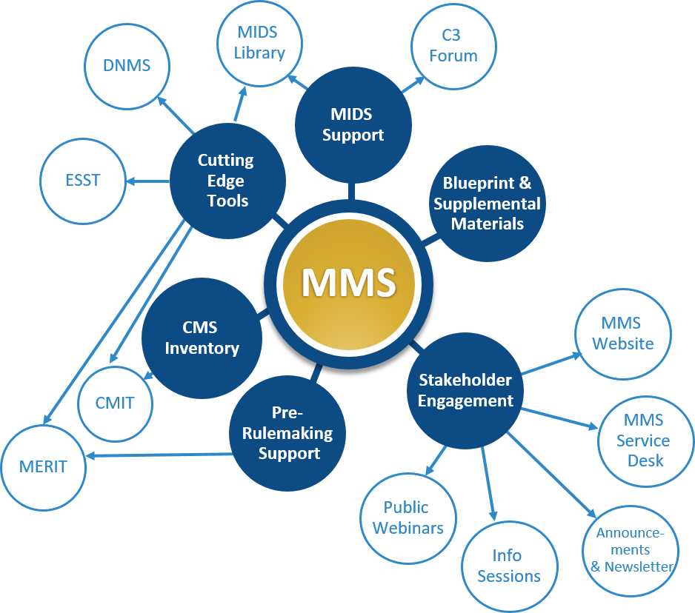
Overview of the Measures Management System (MMS)
CMS developed the MMS to foster and support standardization, flexibility, and innovation in quality measurement through a series of channels.
The MMS conducts stakeholder outreach and education, which includes annual public webinars, monthly information sessions, a newsletter, and other ad hoc outreach activities
2.0
Notes:
Stakeholder engagement
Developer support
CMS MMS Blueprint
Information gathering
CMS program support
Pre-rulemaking support

Slide 4

Background

Slide 5
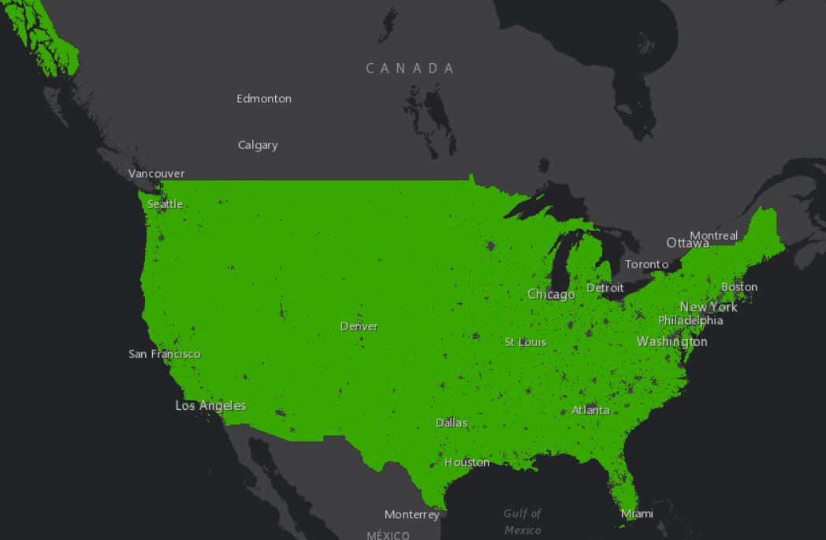
Defining Rurality
Generally, rural communities are micropolitan (areas with 10,000 – 50,000 residents) and include tribal areas and frontier lands.¹
One in five people living in the US live in a rural area.²
Rural areas account for over 97% of land in the US.³
The green areas on map represent all the area in the US that the Census Bureau classifies as “rural.” ³
Sources:
1 https://www.hrsa.gov/rural-health/about-us/definition/index.html
2 https://www.cms.gov/files/document/fy-21-improving-health-rural-communities508compliant.pdf
3 https://www.census.gov/programs-surveys/geography/data/interactive-maps/rural-america-map.html
Notes:
Note that there are a variety of similar definitions.
Sources
https://www.cms.gov/files/document/fy-21-improving-health-rural-communities508compliant.pdf
https://www.hrsa.gov/rural-health/about-us/definition/index.html
https://www.ruralhealthinfo.org/topics/what-is-rural

Slide 6
Health Care Challenges
Compared to their urban counterparts, rural Americans are more likely to:
Experience poverty
  In 2019, 15.4% rural residents lived in poverty compared with 11.9% of urban residents.¹
  Poverty has a significant impact on overall health, a recent analysis found that around 50% of premature death could be attributed to lower socioeconomic status.²
Live in communities that have shortages of primary care, dental health, and behavioral health practitioners
  Rural areas account for approximately 60% of federally designated Health Professional Shortage Areas (HPSA).³
Urban residents living in poverty
Rural residents living in poverty
50% of premature death could be attributed to lower socioeconomic status
60%
Rural areas
Sources:
1 https://www.ers.usda.gov/data-products/chart-gallery/gallery/chart-detail/?chartId=101903
2 https://www.sciencedirect.com/science/article/pii/S2352827318300338
3 https://data.hrsa.gov/data/download
Federally designated Health Professional Shortage Areas

Slide 7
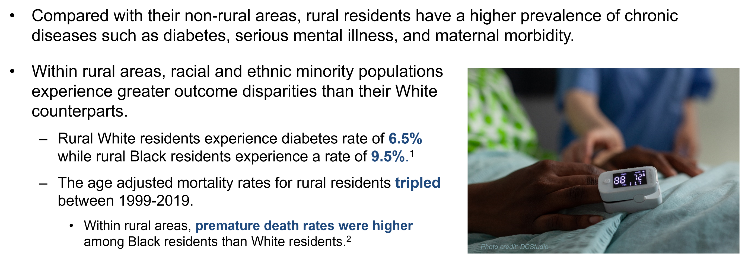
Disparities in Health Outcomes
Sources:
1 https://pubmed.ncbi.nlm.nih.gov/15576542/
2 https://jamanetwork.com/journals/jama/article-abstract/2780628
Notes:
Speaking notes: The healthcare challenges detailed on the prior slide contribute to some pretty significant disparities in health outcomes for rural Americans.

Slide 8


Improving Care: The Role of CMS
Rethinking Rural Health is a vital part of CMS's push to transform the health care delivery system to a model that delivers high quality, affordable, and accessible health care for every American.
Goal is to develop programs and policies that:
  Ensure rural Americans have access to high quality care,
  Support rural providers and not disadvantage them,
  Address the unique economics of providing health care in rural America, and
  Reduce unnecessary burdens in a stretched system to advance our commitment to improving health outcomes for Americans living in rural areas.

Slide 9

Deep Dive:
Rural Health Challenges and Solutions

Slide 10
Common Measurement Challenges in Rural Areas
Challenge 1: Access to Higher Quality Care
Challenge 2: Quality Measure Low Case-Volume
Challenge 3: Participation in Value-Based Payment Programs
Challenge 4: Quality Measure Collecting and Reporting Burden

Slide 11
Challenge 1: Access to Higher Quality Care

Slide 12
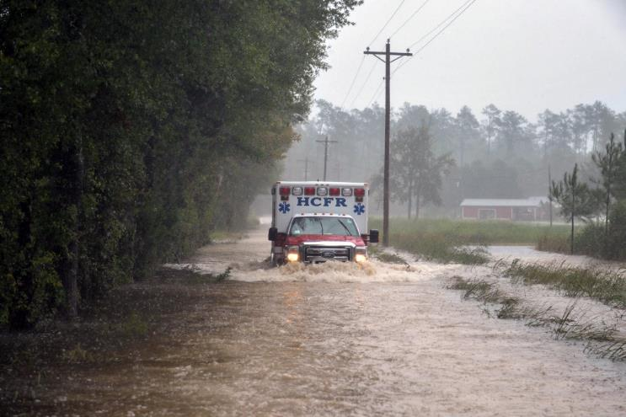
Challenge 1: Access
Healthcare worker shortages
  60% is HPSA are in rural areas and experience a shortage of primary, dental, or mental health providers.¹
Transportation challenges
  Poor infrastructure: U.S. Department of Transportation estimates that 40% of roads in rural areas are “inadequate for current travel.”²
  Limited access to public transportation: Caused by issues associated with travel distance, frequency of service, cost, and funding.³
Distance to medical facilities
  Rural Americans live an average of 10.5 miles from the nearest hospital, compared with 5.6 miles for people in suburban areas and 4.4 for those in urban areas.⁴
Sources:
1 https://data.hrsa.gov/data/download
2 https://www.ruralhealthinfo.org/toolkits/transportation/1/barriers
3 https://www.transportation.gov/mission/health/Rural-Public-Transportation-Systems
4 https://www.pewresearch.org/fact-tank/2018/12/12/how-far-americans-live-from-the-closest-hospital-differs-by-community-type/

Slide 13
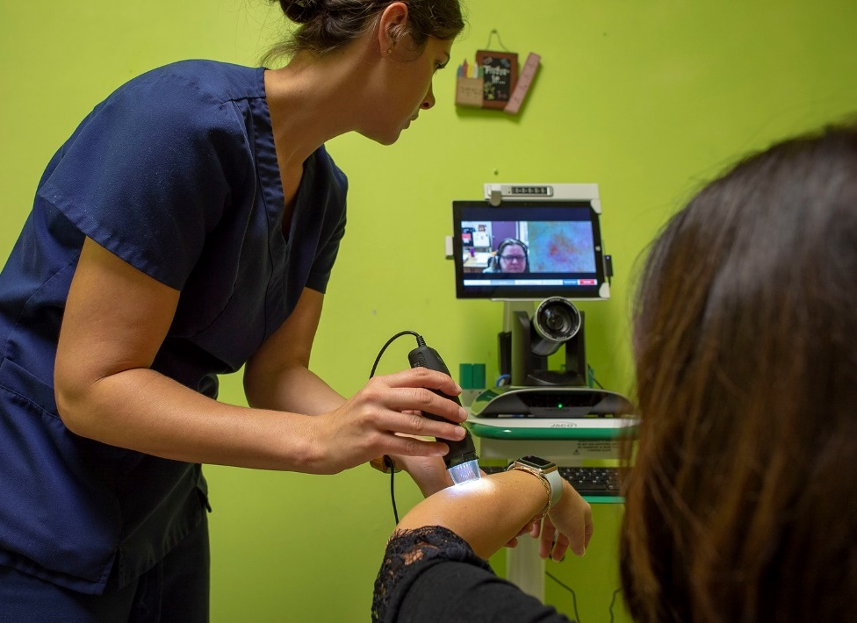
Telehealth: Definition and Value
Telehealth is the use of electronic resources – such as videoconferencing – to support remote clinical health care.¹
Telehealth can improve access to care for rural residents.²
  Telehealth can connect rural residents to providers, both subspeciality and general providers, who are located outside of patients’ geographic area.
  Can lessen/eliminate the need to arrange travel for most routine or non-emergent visits.
Sources:
1 https://www.hhs.gov/hipaa/for-professionals/faq/3015/what-is-telehealth/index.html
2 https://emergency.cdc.gov/coca/ppt/2020/2_COCA_Call-Slides_091520_Final.pdf

Slide 14
Telehealth Challenges
Less access to broadband.
  79% of suburban areas have home broadband compared to 63% of rural areas.¹
Prior to the COVID-19 Public Health Emergency (PHE), payers reimbursed a smaller number of services.²
While telehealth has been in use for over two decades, the ability to assess the quality of care provided is still developing.²
Sources:
1 https://emergency.cdc.gov/coca/ppt/2020/2_COCA_Call-Slides_091520_Final.pdf
2 https://www.qualityforum.org/WorkArea/linkit.aspx?LinkIdentifier=id&ItemID=96378

Slide 15

Increasing Access to Telehealth
The USDA invested in increased infrastructure to access high-speed broadband.¹
Increase reimbursement for telehealth services.
  CMS issued waivers during the COVID-19 PHE that increase the reimbursement rate and number of telehealth services reimbursed.²
Sources:
1 https://www.usda.gov/broadband
2 https://www.govinfo.gov/content/pkg/FR-2020-04-06/pdf/2020-06990.pdf
Notes:
Note: We are focusing on measurement throughout the presentation but wanted to acknowledge the removal/lessening of some longstanding barriers so the audience has a more wholistic look at the process.

Slide 16
Assessing Quality of Care for Telehealth Services
Assessing the quality of telehealth services is an emerging area and not all telehealth is created equal.
CMS and its partners are working on strategies to evaluate the quality of telemedicine to ensure patients receive high quality care.
A foundational step is the CMS-funded framework to support measure development for telehealth.¹
Source:
1 https://www.qualityforum.org/WorkArea/linkit.aspx?LinkIdentifier=id&ItemID=96378

Slide 17

Framework Supporting Telehealth
Measure Development
The framework identified 4 domains:¹
  Access to care
  Financial impact/cost
  Experience
  Effectiveness
Framework included relevant measures and measure concepts that could be used to assess quality of care provided using telehealth.
Source:
1 https://www.qualityforum.org/WorkArea/linkit.aspx?LinkIdentifier=id&ItemID=96378
Notes:
Note: Will explain the domains in talking points

Slide 18
Measuring the Quality of Telehealth Services
In response to the rapid expansion of telehealth services during COVID-19 PHE, CMS funded the creation of Rural Telehealth and Healthcare System Readiness Measurement Framework.¹
  Purpose of this framework was to identify measures that might be adapted to measure telehealth services (during emergency situations).
The framework incorporates unique challenges to providing telehealth in rural areas including:
  Access to devices that allow for video or audio telehealth visits.
  Specific care needs (e.g., rural residents are at higher risk for mental health-, and substance use-related conditions).
Source:
1 https://www.qualityforum.org/WorkArea/linkit.aspx?LinkIdentifier=id&ItemID=96378

Slide 19
Challenge 2: Quality Measure Low Case-Volume

Slide 20
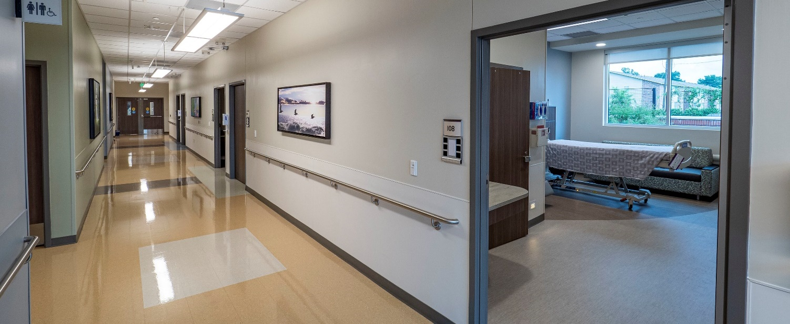
Low Case-Volume
Rural providers experience challenges when they report to value-based programs because they may not have enough cases to meet minimum threshold to calculate the score of a measure. Low case-volume can refer to:
  Too few individuals meet the measure denominator.
  Too few individuals meet the measure numerator.
Presents additional challenges for measures that use sampling.
CMS funded a report that provided recommendations on how to address the low case-volume challenge for rural providers.¹
Source:
1 https://www.qualityforum.org/WorkArea/linkit.aspx?LinkIdentifier=id&ItemID=89672

Slide 21
Recommended Approach
Use a “Borrow strength” methodology to address low case-volume among rural providers.¹
Involves the use of additional data (e.g., performance data from previous years or from other providers) to allow for measurement.
Requires statistical modeling to do correctly.
Relies on the use of “exceedance probabilities” that reflect the amount of uncertainty in the measure results.
May be susceptible to unique unintended consequences.
Source:
1 https://www.qualityforum.org/WorkArea/linkit.aspx?LinkIdentifier=id&ItemID=89672

Slide 22

Methodological Trade-offs
Addressing low case-volume is challenging. The recommended approach (“borrowing strength”) requires:¹
High degree of statistical expertise and computational power.
Mechanism for reporting and interpreting the uncertainty of the measure results.
Active anticipation of potential unintended consequences.
If implemented, the benefits would include:¹
Enabling more rural healthcare entities to participate in measurement programs.
Driving improvements in quality of care.
Improving providers’ access to incentives for providing high quality care.
Promoting informed decision-making among patients by enabling rural healthcare providers to be included in public reporting programs and star ratings.
Source:
1 https://www.qualityforum.org/WorkArea/linkit.aspx?LinkIdentifier=id&ItemID=89672

Slide 23
Challenge 3: Participation in Value-Based Payment Programs

Slide 24
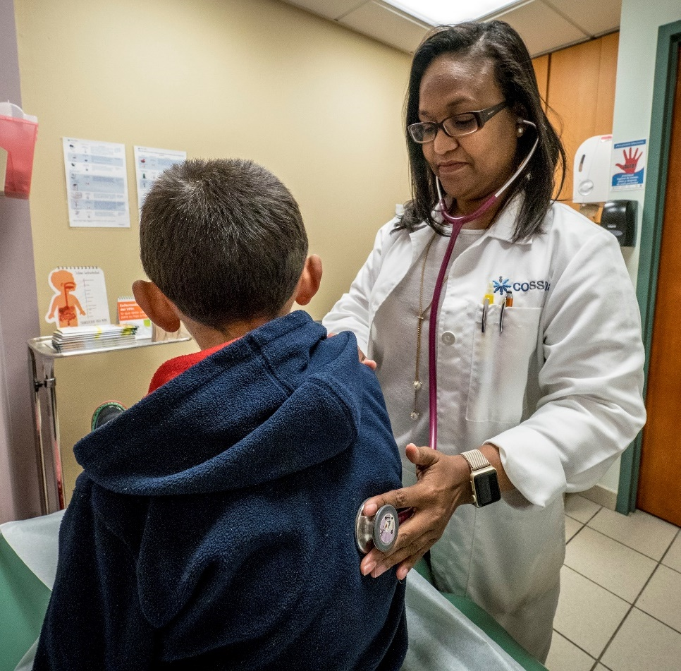
Value-Based Payment Programs
CMS value-based programs reward health care providers with incentive payments for the quality of care they give to people with Medicare.
Historically rural providers experienced challenges participating because of low case volume which is when rural providers do not have enough cases to accurately report a quality measure.
  Though the “Borrowing strength” method may allow rural providers to meet the minimum numerator or denominator to report a quality measure, this methodology isn’t yet widely adopted.

Slide 25

Medicare Beneficiary Quality Improvement Project
To support quality reporting, the Health Research Services Administration (HRSA) designed the Medicare Beneficiary Quality Improvement Project (MBQIP) to promote voluntary quality reporting by Critical Access Hospitals (CAHs).¹
The MBQIP identified a set of existing quality measures that were the most relevant for CAHs.
  Includes measures in four areas:
    Patient Safety/Inpatient
    Patient Engagement
    Care Transitions
    Outpatient.²
Sources
1 https://www.ruralhealthinfo.org/topics/critical-access-hospitals
2 https://www.hrsa.gov/sites/default/files/hrsa/advisory-committees/rural/publications/2021-rural-emergency-hospital-policy-brief.pdf
Notes:
Note: we will define critical access hospitals in the talking points. CAH definition: Critical Access Hospital is a designation given to eligible rural hospitals by CMS. The CAH designation is designed to reduce the financial vulnerability of rural hospitals and improve access to healthcare by keeping essential services in rural communities. To accomplish this goal, CAHs receive certain benefits, such as cost-based reimbursement for Medicare services.

Slide 26

Pre-Rulemaking
CMS uses the pre-rulemaking process for the selection of measures for use in specific CMS value-based programs.
During the process, CMS solicits feedback from stakeholders on proposed measures.
The rural health perspective is a critical piece of the process and CMS established an advisory group for that purpose.

Slide 27
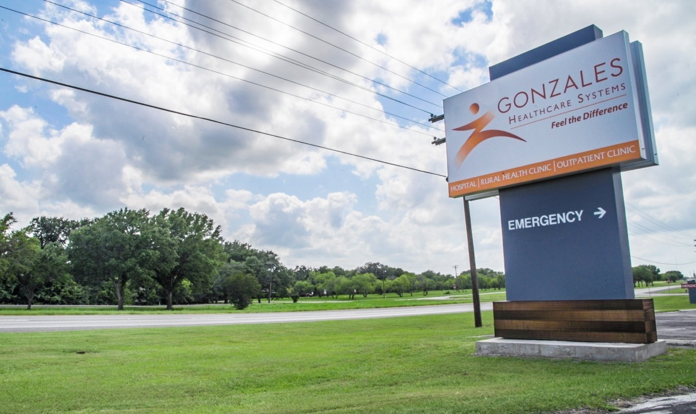
Rural Emergency Hospitals (REHs)
In 2020, Congress created a new provider type – Rural Emergency Hospitals (REHs).¹
REHs are new rural hospital type that will provide 24-hour emergency services.²
Beginning in 2023, REHs will report on measures and that data will be available on CMS website and participate in the pre-rulemaking process.
Sources:
1 https://www.congress.gov/116/bills/hr133/BILLS-116hr133enr.pdf
2 https://www.hrsa.gov/sites/default/files/hrsa/advisory-committees/rural/publications/2021-rural-emergency-hospital-policy-brief.pdf

Slide 28
Challenge 4: Quality Measure Collecting and Reporting Burden

Slide 29
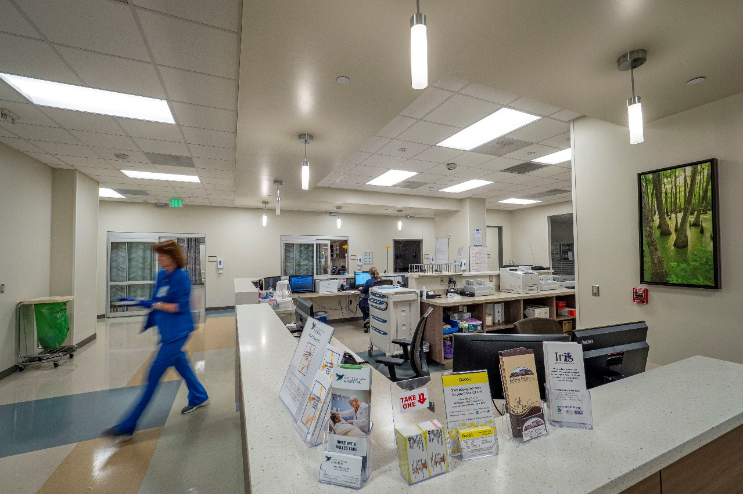
Reporting Burden for Rural Providers
The data collection required to report quality measures can be particularly burdensome for rural providers for several reasons:¹
Rural providers may not have the staff needed to collect data.
  Some measure require a lot of effort, for example, collecting data by hand from medical records.
May not have the resources to invest in or maximize use of high-tech health information systems.
Source:
1 https://www.qualityforum.org/WorkArea/linkit.aspx?LinkIdentifier=id&ItemID=80442

Slide 30
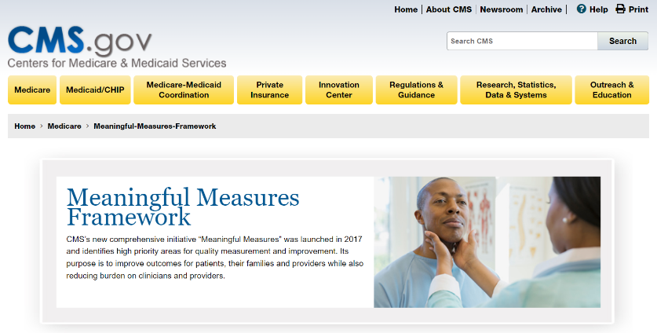
Meaningful Measures 2.0
CMS launched Meaningful Measures (MM) 2.0, which promotes innovation and modernization of all aspects of quality, addressing a wide variety of settings, stakeholders, and measurement requirements.
A goal of MM 2.0 is to transform measures to fully digital by 2025 and incorporate all-payer data.¹
  Digital Quality Measures (dQMs) use health information sources that are reported electronically.
Electronic reporting will reduce burden of providers.
Source:
1 https://www.cms.gov/meaningful-measures-20-moving-measure-reduction-modernization
Notes:
Note: the speaker will say that MM 1.0 reduced number of Medicare quality measures and ease the burden on users. Can site: Overall, the measures portfolio has demonstrated a 25% increase in percentage of outcome measures; the percentage of process measures has dropped from 52% in 2017 to 37% in 2021. https://www.cms.gov/files/document/2021-cms-quality-conference-cms-quality-measurement-action-plan-march-2021.pdf

Slide 31
Alignment
In addition to moving toward measures that reduce reporting burden,
MM 2.0 focuses on measure alignment.
The Core Quality Measure Collaborative (CQMC) is a partnership between America’s Health Insurance Plans (AHIP), CMS, and the National Quality Forum (NQF) to create core sets of measures to align quality measures used by public and private payers.
CMS Cross-Component Alignment Workgroup to help align the use measures:
  In CMS programs and other federal agencies.
  Across private industry, where possible, particularly with respect to the CQMC.

Slide 32
CQMC Core Sets
CQMC core sets:¹
Promote parsimony
  Use of fewer and more meaningful measures.
Alignment
  Measures used across difference programs and payers.
Efficiency of measurement
  Minimum number of measures and the least burdensome measures.
CQMC has core measure sets for conditions disproportionately impact rural residents.
Behavioral Health
Cardiology
Obstetrics and Gynecology
Source:
1 https://www.qualityforum.org/cqmc/

Slide 33
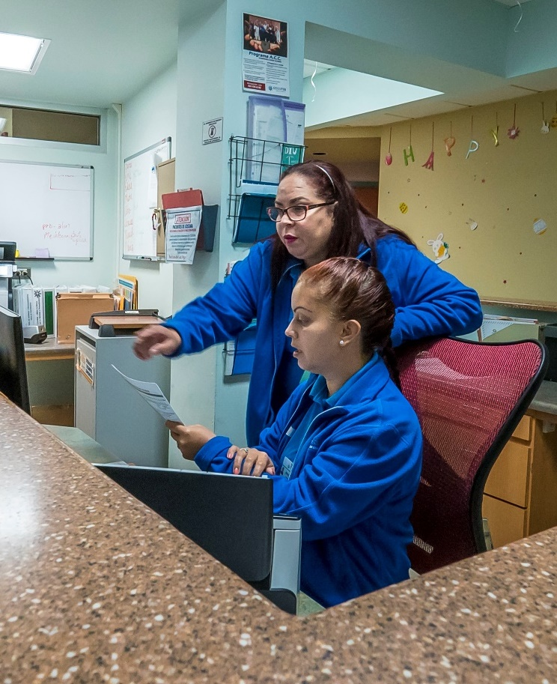
Technical Assistance
CMS and HRSA provide technical assistance (TA) to rural providers to assist with their quality measurement reporting.
As touched on previously, the Medicare Rural Hospital Flexibility Program (Flex) helps CAHs to improve rural health care quality, financial health and hospital operations, and EMS.¹
Sources:
1 https://www.hrsa.gov/rural-health/rural-hospitals/medicare-rural-hospital-flexibility-program-flex
2 https://qpp.cms.gov/resources/small-underserved-rural-practices
Notes:
Note: Will discuss was QPP is and reference the VBP slides previously

Slide 34

Summary
Rural residents experience disparities in health care outcome compared with non-rural residents.
Quality measures are a tool rural providers can use to measure/improve the quality of care their patients receive.
CMS is working with rural providers to:
  Support high-quality telehealth care,
  Address measurement challenges that impact providers ability to report,
  Increase participation in value-based payment programs, and
  Reduce measure reporting burden.

Slide 35
Questions

Slide 36
Get Connected
Want to learn more?
Sign up to receive email updates from MMS, including the monthly MMS Bulletin that features clinical quality measurement announcements, events, and opportunities to get involved.
https://public.govdelivery.com/accounts/USCMS/subscriber/new

Slide 37
Contact CMS
Battelle
Contact: MMSsupport@battelle.org
CMS
Kim Rawlings (CMS COR)
Contact: kimberly.rawlings@cms.hhs.gov

