Slide 1



Gravity Project
Evelyn Gallego, MBA, MPH, CEO at EMI Advisors LLC, Senior Advisor at Gravity Project
Sarah DeSilvey, DNP, FNP, Director of Terminology at Gravity Project

Slide 2

MMS Information Session Goals
Part of a larger effort to engage stakeholders and the public in quality measure development.
Additional activities the MMS team leads:
  Annual public webinars on high-priority CMS topics
  Outreach via our stakeholder listserv and
  the CMS MMS listserv
  MMS website updates and maintenance
  Development and promotion of emerging
  tools and resources
  MACRA-specific education and outreach
Notes:
CMS is committed to providing Education and Outreach opportunities about the quality measure development process to interested stakeholders to improve understanding of the process. CMS also seeks continual feedback to improve and/or expand its offerings to the healthcare quality measure development community and interested stakeholders.
To date, CMS has implemented an Education and Outreach webinar series and has created resource materials that break down and explain various components and challenges in the measure development process. There are dedicated websites, listservs, and roadmap documents that are available to support those that are working in quality measure development, or are just curious and want to learn more about how it is done.

Slide 3


Meet Our Speakers
Evelyn Gallego
Gravity Project
Senior Advisor
Sarah DeSilvey
Gravity Project
Terminology Director

Slide 4
Agenda
Background: Our WHY
Project Scope & Accomplishments: Our WHAT
National Quality Measures Alignment
How to Engage

Slide 5
A Social Determinants of Health Lexicon
Health Equity is “achieved when every person has the opportunity to attain his or her full health potential and no one is disadvantaged from achieving this potential because of social position or other socially determined circumstances”.
  Social Determinants of Health: “the conditions in which people are born, grow, live, work and age,” which are “shaped by the distribution of money, power and resources.
    Protective Factors: characteristics or strengths of individuals, families, communities or societies that act to mitigate risks and promote positive well-being and healthy development.
    Social Risks: Adverse social conditions associated with poor health.
    Social Needs: Non-medical patient prioritized needs that impact health.
Addressing structural and individual SDOH are critical steps to improve equity and reduce disparities.
Systems Level
Community Level
Individual Level
Alderwick and Gottlieb (2019) Meanings and Misunderstandings: A Social Determinants of Health Lexicon for Health Care Systems
Center for the Study of Social Policy (2018) About Strengthening Families™ and the Protective Factors Framework
Physician-Focused Payment Model Technical Advisory Committee (2021) SDOH and Equity Report to the Secretary
Notes:
SDOH—Is neither positive nor negative and rather are attributed to protective/positive factors and social risks, and are acted on by patient-identified and prioritized needs.
Health Equity—Biden administration has stressed it and addresses SDOH as a primary approach to achieving health equity; however, it is not the only means.

Slide 6
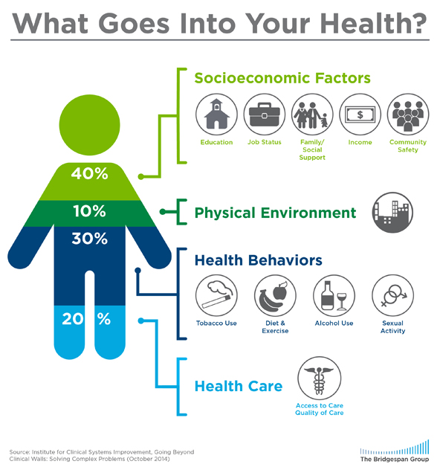



Why SDOH are Important
What Goes Into Your Health?
There is growing awareness that unmet social needs negatively impact health outcomes.
Food insecurity correlates to higher levels of diabetes, hypertension, and heart failure.
Housing instability factors into lower treatment adherence.
Transportation barriers result in missed appointments, delayed care, and lower medication compliance
https://www.bridgespan.org/insights/library/public-health/the-community-cure-for-health-care-(1)
Notes:
Over 50% of overall health is driven by socioeconomic factors and the physical environment. These unmet social needs therefore negatively impact health outcomes of which COVID has only magnified this fact as we learn more about these increasing health disparities.

Slide 7
Challenges in SDOH Data Capture and Exchange
Standardization of SDOH Data Collection and Storage
Data Sharing Between Ecosystem Parties
Access & Comfort with Digital Solutions
Concerns about Information Collection and Sharing and Duplicative Data Entry
Social Care Sector Capacity and Capability
Unnecessary Medicalization of SDOH
Consent Management
Competing State & Local Networks
Managing Diverse Needs of Stakeholders
Sustainable Funding Models
https://www.nasdoh.org/wp-content/uploads/2020/08/NASDOH-Data-Interoperability_FINAL.pdf
https://aspe.hhs.gov/sites/default/files/migrated_legacy_files//199726/social-determinants-health-data-sharing.pd f
Notes:
The Gravity Project primarily addresses the two challenges highlighted in red, the standardization of this data for collection and storage and exchange, and sharing it across ecosystem parties. There are still other challenges, with some of them listed here, that still need to be met and addressed across the industry.

Slide 8



A collaborative public-private initiative launched in May 2019 with the goal to develop consensus-driven data standards to support the collection, use, and exchange of social determinants of health (SDOH) data.
Gravity Project
7

Slide 9
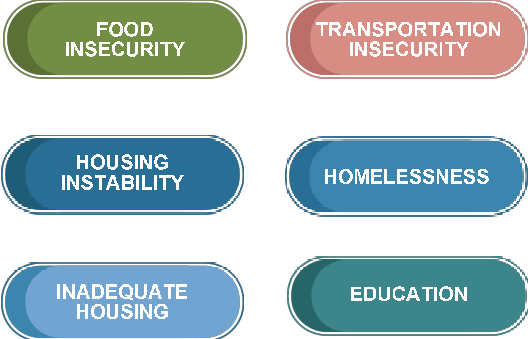
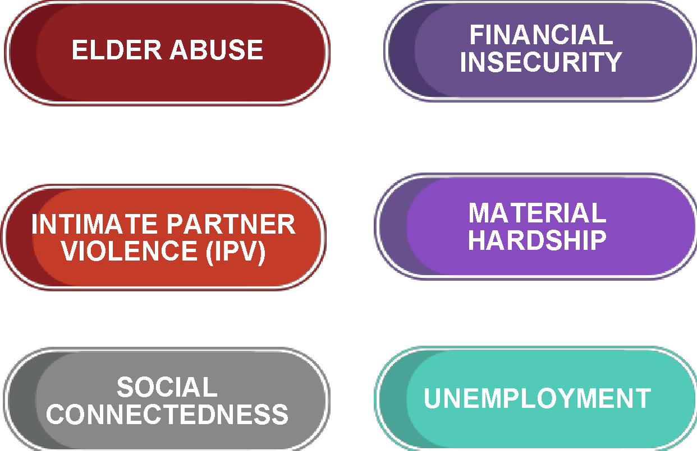





Project Scope
SDOH Domains
Develop data standards to represent and exchange patient level SDOH data documented across four clinical activities:
  Screening,
  Assessment/diagnosis,
  Goal setting, and
  Treatment/interventions.
Test and validate standardized SDOH data for use in patient care, care coordination between health and human services sectors, population health management, public health, value-based payment, and clinical research.
Domains grounded by those listed in the NASEM “Capturing Social and Behavioral Domains in Electronic Health Records” 2014
Notes:
The Gravity Project has completed 17 SDOH domains (shown on the right), grounded by those included in the National Academies of Sciences, Engineering and Medicine (NASEM) 2014 report on capturing social and behavioral domains. They are also driven by the Healthy People 2030 domains.

Slide 10
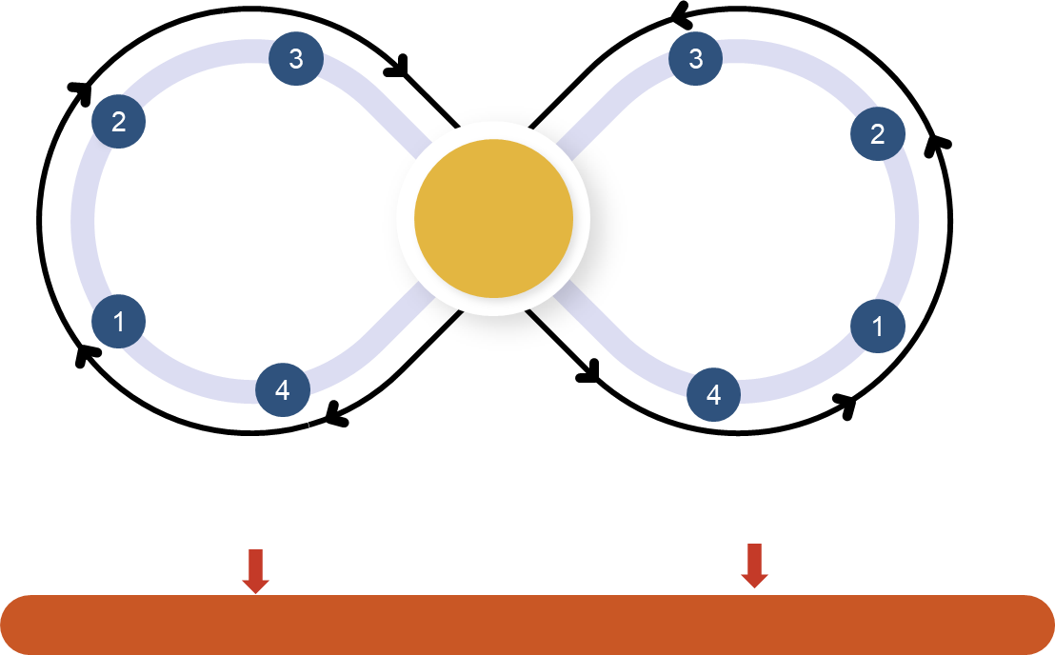
Project Execution:
Three Workstreams (Terminology, Technical, Pilots)
New Code Submissions
FHIR IG Testing
Coding Gap Analysis & Recommendations
FHIR IG Development
Terminology (SDOH Domains)
CODED VALUE SETS
Technical (HL7 FHIR)
Data Set Identification
Community & FHIR Coordination
Publication in NLM VSAC & ONC ISA
FHIR IG Ballot & Publication
Pilots (Testing & Implementation)
Notes:
Terminology workstream—Primarily focuses on developing the domains, the data concepts, submitting for new codes and more importantly, developing and publishing the coded value sets in the National Library of Medicine (NLM) and Value Set Authority Center (VSAC).
Technical workstream—Is working on the FHIR standards and specifications.
Pilots workstream—Will launch September 2022 with a focus on testing and validating both the terminology and the technical standards.

Slide 11
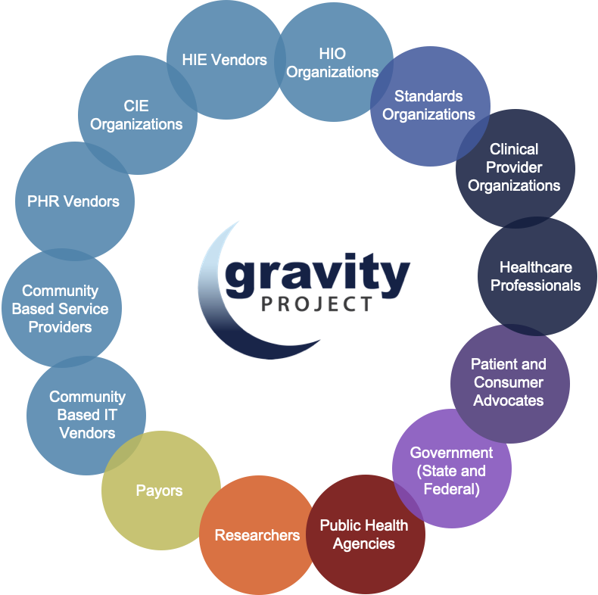




Public Collaboration via 2 Public Workgroups
Gravity has convened over 2,500+ participants from across the health and human services ecosystem.
Terminology Workstream Products developed via Public Collaborative.
Meet bi-weekly on Thursdays from 4 to 5:30 pm ET.
Technical Workstream Products developed via HL7 SDOH FHIR IG WG.
Meet weekly on Wednesdays from 3 to 4 pm ET.
https://confluence.hl7.org/pages/viewpage.action?pageId=46892669#JointheGravityProject-GravityProjectMembershipList
Notes:
The health and human services ecosystem includes entities that participate not only from clinical care or health IT vendors, but CBOs, public health, research, academia and health plans. This ability to engage and collaborate across these diverse stakeholder groups truly sets Gravity apart as a standards-based project.

Slide 12









































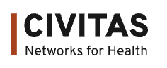
Project Founders, Grants, and In-Kind Support To-Date
PROVIDER
SOCIAL SERVICES
PAYER
TECHNOLOGY VENDOR
GOVERNMENT
Yale School of Nursing
siren
NC
https://confluence.hl7.org/display/GRAV/Gravity+Project+Sponsors
Notes:
The Gravity Project is not an entity, but instead a project funded by multiple organizations through in-kind and financial sponsorships. It receives support from the federal government, including CMS, ONC, the Administration for Community Living (ACL), AHRQ and CDC. Other contributors are health systems, private payors, philanthropies and technology vendors.

Slide 13
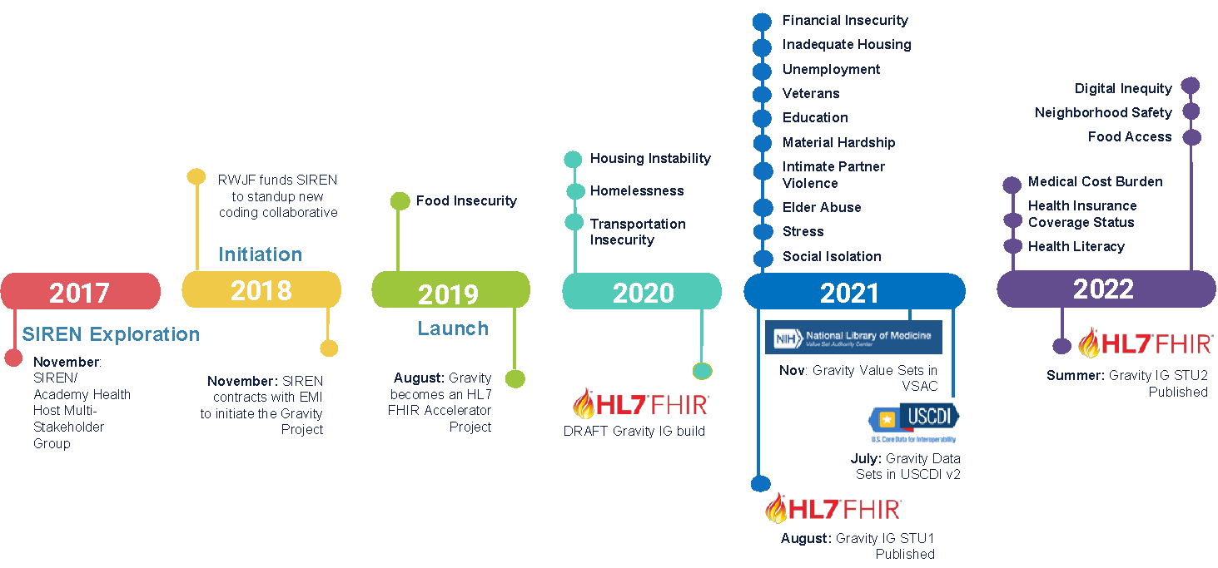
Gravity Timeline
Notes:
2017—Gravity began when the Social Interventions Research and Evaluation Network (SIREN) at the University of California-San Francisco convened over 50 individuals from across the health services sector in Washington D.C. to discuss the issue of the lack of codes available to represent social risk data in EHRs.
May 2019—Launched Gravity in May of 2019 with funding from the RWJF and focused on developing datasets for food insecurity facilitated by Dr. Sarah DeSilvey, Food Insecurity SME.
August 2019—Gravity became an HL7 FHIR Accelerator Project to ensure that the work advances the use of the FHIR specifications for health data exchange.
2020—Gravity shifted to working on multiple domains at a time, and also began work on the HL7 SDOH FHIR Implementation Guide (IG) and initiated testing it at the HL7 FHIR Connectathons.
2021—Published datasets and completed code submissions for 11 domains and published the FHIR Implementation Guide (IG) as the standard for trial use (STU) Version 1, for which datasets were included in national policy as data classes in the U.S. Core Data for Interoperability or USCDI Version 2.
2022—Gravity is primarily focused on the dissemination and testing of this work, with the launch of the pilots workstream.

Slide 14
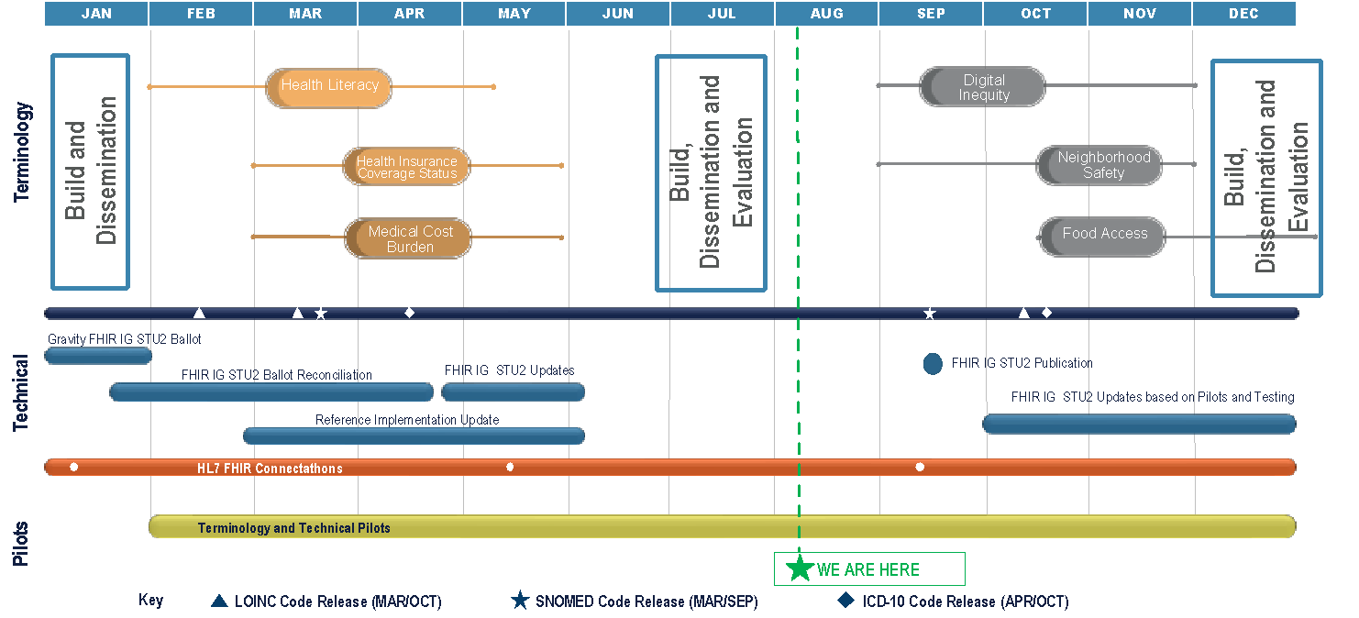
Gravity 2022 Roadmap
Notes:
Gravity has completed three domains thus far in 2022 — health literacy, health insurance coverage and medical cost burden. Proposed in the fall is the kickoff of three new domains — digital and equity, neighborhood safety and food access. Gravity is on target to publish Version 2 of the FHIR IG which is to be published September 2022. The pilots will officially kick off September 27th.

Slide 15



Terminology Workstream

Slide 16
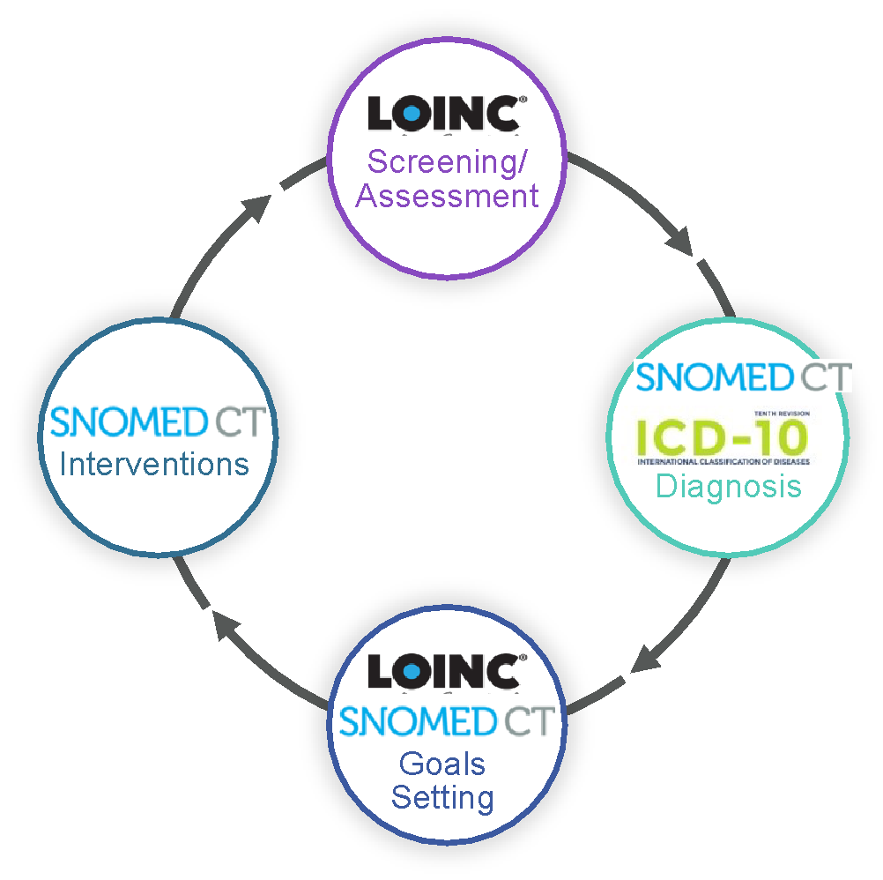
Terminology Workstream Accomplishments
Data definitions and code submissions for 17 SDOH Domains
LOINC screener codes available for 15 domains
ICD-10 z-codes available for 12 domains (8 codes included in FY2023 CMS IPPS Proposed Rule)
SNOMED-CT Diagnoses codes available for 16 domains
SNOMED-CT intervention codes available for 17 domains
Published 123 value sets in National Library of Medicine (NLM)
Data class included in ONC USCDI v2
https://confluence.hl7.org/display/GRAV/SDOH+Data+Elements+And+Status
Notes:
The terminology workstream focuses on defining data concepts for SDOH domains. The graphic on the right illustrates which code systems are used to define concepts across the four activities.
What concepts need to be documented across screening, diagnosis, goals setting, and interventions?
Once concepts are defined, what codes exist/new codes to be developed?

Slide 17


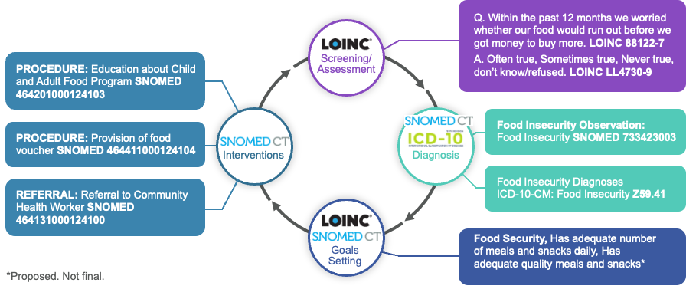
Food Insecurity Terminology Build
FOOD
INSECURITY
FOOD DESERTS
Notes:
This slide illustrates how coded food insecurity data concepts are represented across the four clinical activities.
LOINC is used to code question/answer sets for screening and goals.
SNOMED is used to represent food insecurity observations and food insecurity interventions.
ICD-10 is predominately used to represent diagnosis via z codes.

Slide 18
Interventions Framework
Gravity Term | Definitions
Assistance/Assisting | To give support or aid to; help
Coaching | Method of instruction, direction, or promoting that can include demonstration, reinforcement, motivation and feedback to improve performance, or achieve a specified goal.
Coordination | Process of organizing activities and sharing information to improve effectiveness
Counseling | Psychosocial procedure that involves listening, reflecting, etc. to facilitate recognition of course of action/solution.
Education | Procedure that is synonymous with those activities such as teaching, demonstration, instruction, explanation, and advice that aim to increase knowledge and skills.
Evaluation of eligibility (for <x>) Subtype of Evaluation | Process of determining eligibility by evaluating evidence
Evaluation/Assessment | Determination of a value, conclusion, or inference by evaluating evidence.
Provision | To supply/make available for use
Referral | The act of clinicians/providers sending or directing a patient to professionals and/or programs for services (e.g., evaluation, treatment, aid, information, etc.)
Notes:
On the left is a summary of eight interventions. To facilitate this work in terminology development first define the approach via a framework for building intervention terminologies by grounding variables into common definitions.
Coordination—In thinking about the role of medical/social care integration, there is much coordination to care plans and available resources that funnel into the social care space. Gravity aligned this term with the AHRQ definition.

Slide 19
Terminology Activities Under Consideration 2022+
Domains
  Minority Strain/Discrimination and Bias
  Green Space
  Adverse Childhood Experiences (ACES)
  Expanded Material Hardship Elements
  Incarceration
  Migrant Laborers
  Others based on Healthy People 2030 Objectives
Activities
  “Accounting for care”- Social care CPTⓇ, CPTⓇ Category II, and HCPCs codes to enhance quality, evaluation, and value-based partnerships.
  Social care and health care shared ontologies and open taxonomies.
  Develop supplemental terminology deliverables to address sharing information on social care program eligibility and enrollment.
  Participate in quality measure development to lend coding, content, and measurement insight relevant to Gravity’s work.
Notes:
The Gravity Project is focused on adjusting minority strain/discrimination and bias and addressing ACES through TEP expertise slated for Winter-2023.

Slide 20
Quality Measures Alignment

Slide 21
Social Care QMs: Considerations
Defining the intent. What will the data tell us? How will it help?
  Screen
    Capacity Building
  Screen and Positive Rate
    Capacity Building + Population-Level Risk
  Screen and Intervene
    Capacity Building + Intent to Assist (akin to screen and intervene measures)
  Intervention Success/Social Needs Met:
    Connection to Services
    Patient-Reported Satisfaction
    Reduction in Severity (dependent on quality/breadth of initial screening methods- akin to remission measures)
Digital Quality Measures (dQMs)

Slide 22
Technical Workstream

Slide 23


Technical Workstream Powered By
Notes:
On this slide Gravity acknowledges the in-kind support and the entities that support it in providing the resources to lead and advance this work. The technical workstream phase is currently sponsored by NewWave and the American Medical Association (AMA).

Slide 24

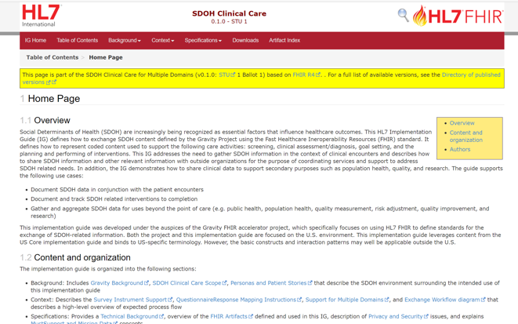
HL7 SDOH Clinical Care
FHIR Implementation Guide
This is a framework Implementation Guide (IG) and supports multiple domains
IG support the following clinical activities
Assessments
Health Concerns / Problems
Goals
Interventions including referrals
Consent
Aggregation for exchange/reporting
Exchange with patient/client applications
Draft specifications for race/ethnicity exchange
STU1 published August 2021
STU2 balloted in HL7 January 2022 Ballot Cycle; target Summer 2022 publication
http://hl7.org/fhir/us/sdoh-clinicalcare/STU1/

Slide 25
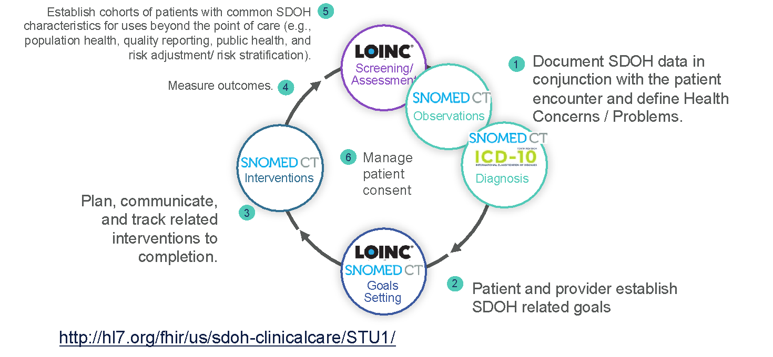
Technical Workstream FHIR Implementation Guide Use Cases
Notes:
1st use case—Document the SDOH or social risk/social needs data as part of the patient encounter and define the health concerns and the problems.
2nd use case—Define the patient/provider SDOH-related goals, meaning the social needs as defined through goal setting.
3rd use case—Taking action on the problem/goals identified, so use cases around planning or communicating and tracking related interventions to completion to include closed-loop referrals.
4th use case—Measuring the outcomes of these activities.
5th use case—Establish cohorts of patients with common SDOH characteristics for use beyond point of care with an ability to aggregate data for upstream use for population health, and downstream for quality reporting.

Slide 26








July CMS Connectathon:
Gravity Track Demonstrations
Session 1: Assessment and Closed Loop Referral Data Exchange
Session 2: Assessment, Closed Loop Referral, and REL + SOGI data exchange
https://confluence.hl7.org/display/FHIR/CMS+2022+-+07+Gravity+SDOH+Track
Notes:
Session 1—Organizations came to test focused on having closed-loop referrals with assessments and screening, as well as a focus on referral interventions.
Session 2—Some entities incorporated race/ethnicity data and SOGI data exchange, which are not Gravity data, but instead are defined as part of the Gravity Project through other HL7 projects.

Slide 27
Technical Activities
Under Consideration 2022+
Define and identify methods of anonymization of data to support reporting for public health (where deidentified data is appropriate).
Develop use cases and requirements for aggregation and de identification of SDOH information for population health and research.
Develop and/or incorporate new use cases that can be supported by existing FHIR IG:
  CBO to CBO Data Exchange
  CBO to State Agency Data Exchange
Notes:
Develop/incorporate new use cases supported by existing FHIR IG—This work is grounded in data captured within an EHR. These are clinical activities, but community feedback dictates a need to define the data exchange between one CBO to another, as well as CBO to state agency. Currently, these activities are playing out in the field, however not by using standards-based approaches.

Slide 28
Pilots Workstream

Slide 29
Pilots Workstream Powered By
Notes:
The Gravity Project is pleased to announce the kickoff of the pilots workstream monthly webinars set to commence in September. This work is being sponsored by the Office of the National Coordinator (ONC), the Administration for Community Living (ACL), AARP, and with the addition of the IHE which is part of HIMSS.

Slide 30
Gravity Three-Tiered Piloting Approach
Defines incremental tiers for testing Gravity standards (terminology and technical)
  Will allow entities with limited health IT standards adoption to reach attainable milestones during Piloting Phases.
  Entities may participate at any Tier.
Tier I
Basic, information content verification
Establish information infrastructure and terminology for Tiers II and III
Information can be exchanged by any method or not at all
* Minimum requirements for Gravity Pilots
Tier II
Secure, Electronic Information Exchange
Exchange data defined in Tier I
Leverage established content and transport standards
Tier III
Complete Gravity SDOH Data Model and Exchange
Implement complete Gravity FHIR IG data model
Implement Gravity FHIR IG exchange standards
Import/export SDOH datasets via robust technologies
Primary focus of FHIR Pilots

Slide 31
Call for Participation!
We are currently seeking entities to participate in testing the Gravity defined coded concepts and/or the HL7 SDOH FHIR IG STU1 and/or STU2.
We will be standing up a Pilots Affinity Group in September 2022 to convene participating sites via a monthly webinar. Stay tuned!
Please submit your Pilot interest to gravityproject@emiadvisors.net

Slide 32
Funded Pilots Testing Gravity Standards
ONC Awardees
OCHIN
Alliance Chicago
UT Austin (LEAP Awardee) https://www.healthit.gov/buzz-blog/interoperability/by-leaps-and-bounds-newest-round-of-awardees-seek-to-advance-health-equity-and-research
ACL Phase 2 Challenge Teams
Closing the Loop Together in Southeast Michigan
FHIR-FLI
Missouri Aging Services Data Connectivity & Interoperability
Thrive Hub South Carolina Referral System
https://acl.gov/news-and-events/announcements/acl-announces-social-care-referrals-challenge-phase-2-awardees
Notes:
As we await the official launch of the Pilots Affinity Group, we recognize the funded organizations here that test and demonstrate the Gravity standards:
All sites are at initial stages of implementation, with the assistance of the EMI project team in preparation for testing.
OCHIN and Alliance Chicago are in the process of receiving funding from ONC via HL7 to specifically test FHIR resources not included in US Core.
UT Austin is testing closed loop referral, along with the ACL challenge teams also testing closed loop referrals between health systems and CBOs.

Slide 33
Success Factors

Slide 34
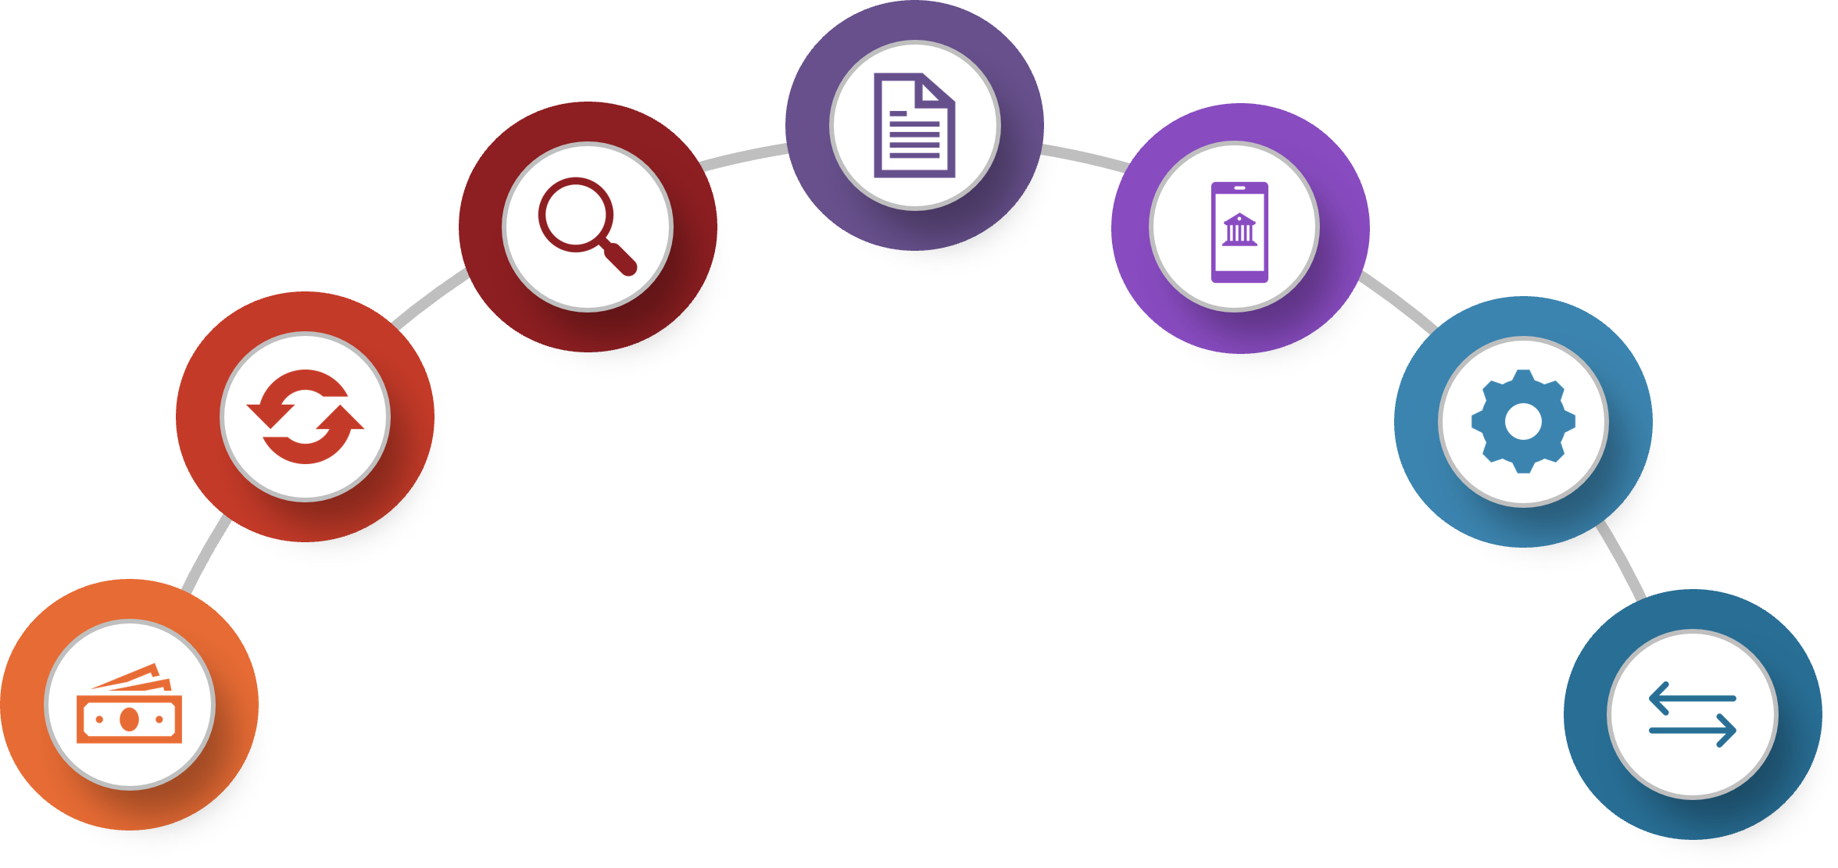

Success Factors—
Integration of Data Standards Into…
POLICY
(e.g., ONC USCDI, CMS Promoting Interoperability, State Medicaid Director Letters)
INNOVATION
New tools for capture, aggregation, analytics, and use.
PAYMENT MODELS
(e.g., CMMI SDOH Model)
PRACTICE
(e.g., repeatable process for adoption, implementation, and use of SDOH data at practice level).
PROGRAMS
(e.g., Medicare Advantage, Medicaid Managed Care, Hospital QRRP, MIPS).
GRANTS
(e.g., ACL Challenge Grant, ONC Health IT LEAP)
OTHER STANDARDS
HL7 FHIR Accelerators (DaVinci, Argonaut, CARIN)
Notes:
Clearly, the value of this work is the integration into other areas. This requires having incentives to ensure that standards are adopted and used. Gravity is grateful to inform some of the CMS rules at the program level.
At the grants level we have examples of the inclusion of Gravity standards. As a requirement for receipt of a grant you must test or incorporate a standard. At the practice level, we seek partners to assist with finding repeatable processes for the adoption and implementation of social needs data, as well as informing new tools in the market for capture aggregation in analysis.

Slide 35
Gravity Standards Included in Policy, Programs, & Grants
July 2021: Gravity data elements included in ONC USCDI version 2
May 2022: CMS CY 2023 Medicare Advantage (MA) and Part D final rule requires Special Needs Plans (SNPs) include standardized questions on housing stability, food security, and access to transportation as part of their currently required health risk assessments.
  CMS will issue sub-regulatory guidance on the questions but intends to align them with the SDOH Assessment data element in USCDI v2.
August 2022: CMS FY 2023 inpatient prospective payment system (IPPS) and long-term care hospital (LTCH) final rule includes voluntary screening and identification of patient-level health-related social needs using USCDI v2 SDOH data classes.
Gravity standards included in three federal grant programs:
  Administration for Community Living (ACL) Social Care Challenge Grant
  ONC Leading Edge Acceleration Projects (LEAP) in Health IT Referral Management to Address SDOH Aligned with Clinical Care
  Administration for Children & Families (ACF) Human Services Interoperability Innovations Grant

Slide 36
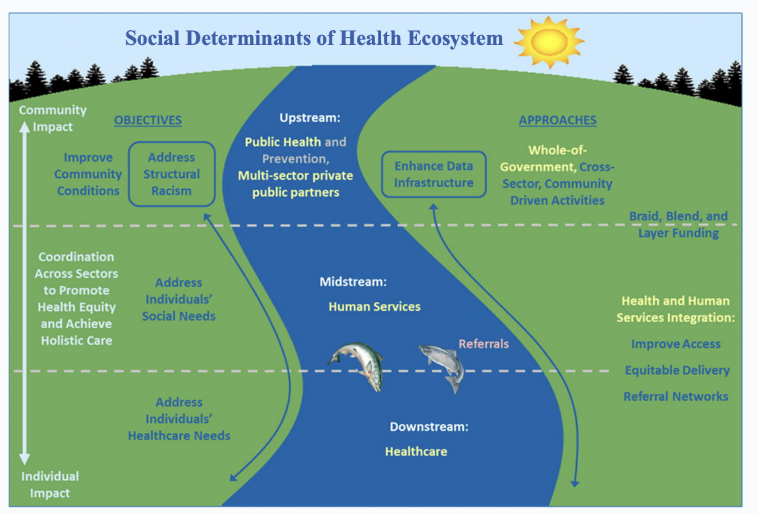
Gravity Alignment to HHS Strategic Approach to Addressing SDOH to Advance Health Equity
Data standards to support health and human services integration
https://aspe.hhs.gov/sites/default/files/documents/aabf48cbd391be21e5186eeae728ccd7/SDOH-Action-Plan-At-a-Glance.pdf
Notes:
HHS published this in Summer 2022, and this visual is from that report, that our work is primarily focused on data standards to support the HHS integration. Currently, Gravity is at the middle level, with the objective of supporting the upstream and downstream activities as elaborated upon in the report.

Slide 37
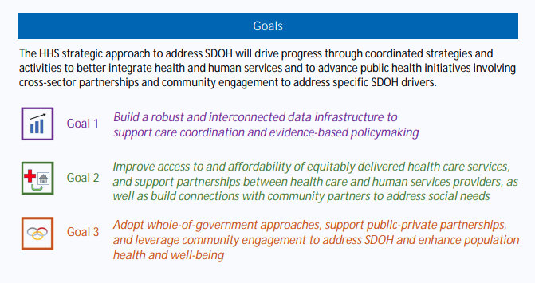
Gravity Alignment to HHS Strategic Approach to Addressing SDOH to Advance Health Equity
https://aspe.hhs.gov/sites/default/files/documents/aabf48cbd391be21e5186eeae728ccd7/SDOH-Action-Plan-At-a-Glance.pdf

Slide 38
How to Engage!

Slide 39
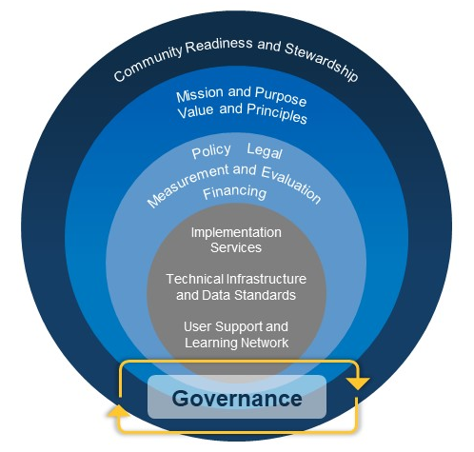
Establish SDOH Information Exchange Foundational Elements
https://www.healthit.gov/news/events/oncs-social-determinants-health-information-exchange-learning-forum
Notes:
ONC is set to publish an SDOH information exchange toolkit. This link will take you to a series of learning forums which review the toolkit components and can serve as guidance more broadly for entities interested in social care integration, or in the establishment of community information exchanges. There is also currently much work with TEFCA, but with a social care lens.
Governance
Before commencing any initiatives, before exchanging data or establishing data-sharing agreements, create your governance.
Ensure that you have buy-in from all entities involved.
Consider all existing community networks and bring them to the table before stating requirements or establishing the data-sharing agreements.

Slide 40



Join the Gravity Project!
Submit SDOH domain data elements (especially for Interventions): https://confluence.hl7.org/display/GRAV/Data+Element+Submission
Help us with Gravity Education & Outreach
Use Social Media handles to share or tag us
to relevant information
@thegravityproj
https://www.linkedin.com/company/gravity-project
Learn More
https://confluence.hl7.org/display/GRAV/Join+the+Gravity+Project
Workgroup meets bi-weekly on Thursdays’ 4:00 to 5:30 pm ET
SDOH FHIR IG Workgroup s. 3:00 to 4:00 pm ET
Help us find new sponsors and partners
Partner with us on development of blogs, manuscripts, dissemination materials

Slide 41









Gravity PMO Team
Evelyn Gallego
Senior Advisor
evelyn.gallego@emiadvisors.net
Jillian Annunziata
Program Manager
jillian.annunziata@emiadvisors.net
Gabriela Gonzalez
Pilots Lead
gabriela.gonzalez@emiadvisors.net
@egallego
linkedin.com/in/egallego/
@j_Nunz4
linkedin.com/in/jillianannunziata/
linkedin.com/in/gabgonza7/
Sarah DeSilvey
Clinical Informatics Director
sarah.desilvey@med.uvm.edu
Greg Harris
Acting Technical Director
Mark Savage
SDOH Policy Lead
MarkSavage.eHealth@pacbell.net
Lenel James
Payer Advisor
gregory.harris@newwave.io
Lenel.James@bcbsa.com
@sarcandes
@SavageMeHealth
linkedin.com/in/sarah-desilvey-fnp/
linkedin.com/in/mark-savage-34aa03126/
linkedin.com/in/lenel-james-4435ba
Additional questions? Contact: gravityproject@emiadvisors.net or visit https://thegravityproject.net

Slide 42
Discussion Questions

Slide 43
Announcements
September 14 Info Session – How QIN’s use Quality Measures for Quality Improvement
September 28 Info Session – How CMS Uses Quality Measures

Slide 44
CMS
Melissa Gross (CMS Lead)
Contact: Melissa.Gross@cms.hhs.gov
Battelle
Contact: MMSSupport@battelle.org

