Slide 1
PUBLIC WEBINAR
Digital Quality Measurement Strategic Roadmap
Presenter:
Joel Andress (CMS)
August 2022

Slide 2

Welcome and Learning Objectives
During this public webinar, participants will learn about CMS’s Digital Quality Measurement (dQM) Quality Measurement Strategic Roadmap, a multipronged strategy to provide better access to usable, timely data to improve quality measurement and patient care.

Slide 3
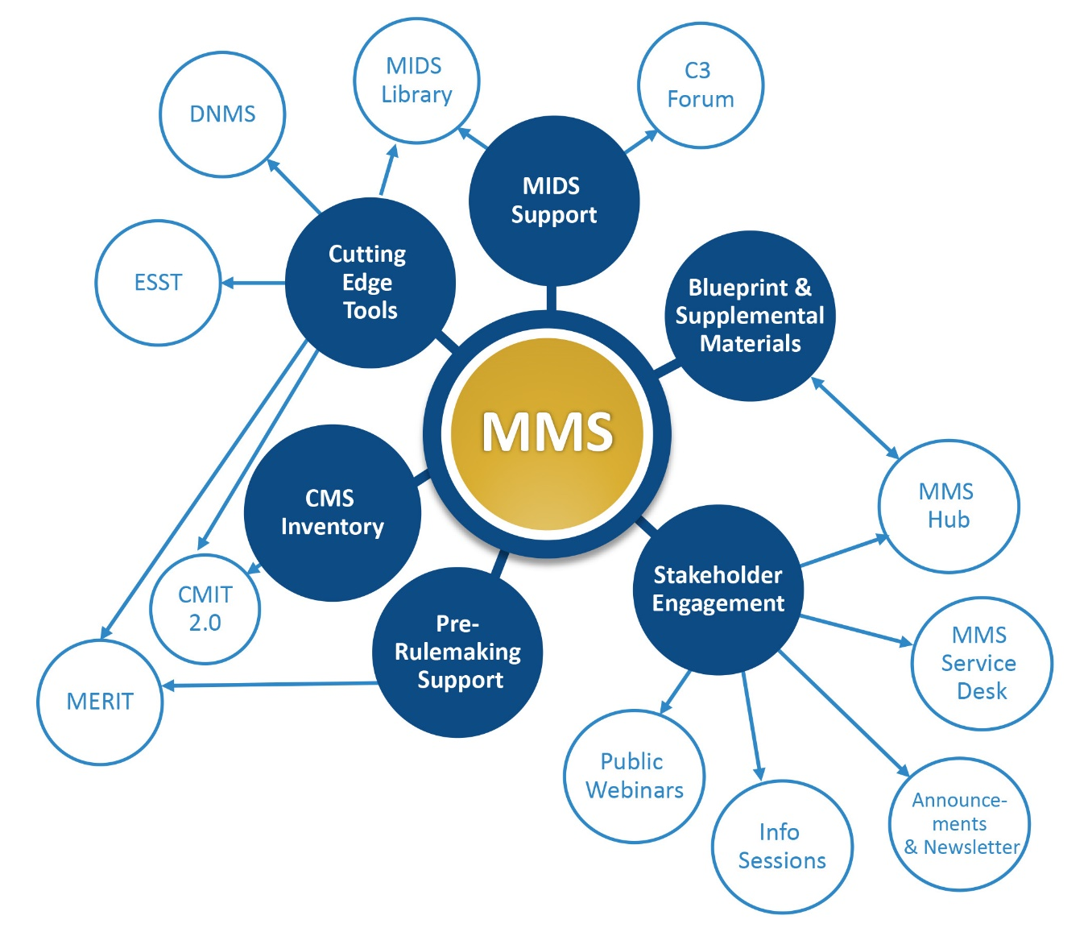
Overview of the Measures Management System (MMS)
CMS developed the MMS to foster and support standardization, flexibility, and innovation in quality measurement through a series of channels.
The MMS conducts stakeholder outreach and education, which includes annual public webinars, monthly information sessions, a newsletter, and other ad hoc outreach activities.
CMIT - CMS Measure Inventory Tool
DNMS - De Novo Measure Scan
ESST - Environmental Scan Support Tool
MERIT - MUC Entry/Review Information Tool
MIDS - Measure and Instrument Development and Support
Notes:
The diagram depicted on the right showcases the many activities of MMS, of which the stakeholder engagement circle in dark blue includes education and outreach along with this public webinar.
MMSHub.CMS.gov
Launched Spring 2022,
Transforms the 100-page MMS Blueprint into a comprehensive, user-friendly website, and
Highlights upcoming engagement opportunities, including TEPs and MMS educational resources.

Slide 4

Digital Quality Measurement Strategic Roadmap

Slide 5
Disclaimer
This presentation is current at the time of publication or upload onto the web. Medicare policy changes frequently so links to the source documents have been provided within the document for your reference.
This presentation was prepared as a service to the public and is not intended to grant rights or impose obligations.
This presentation may contain references or links to statutes, regulations, or other policy materials.
The information provided is only intended to be a general summary. It is not intended to take the place of either the written law or regulations. We encourage readers to review the specific statutes, regulations, and other interpretive materials for a full and accurate statement of their contents.
Notes:
Please note this mandatory disclaimer included simply to state that the presentation issues addressed in this slide deck are not meant to stand in for statutes, regulations, or other finalized policies at CMS.

Slide 6
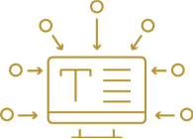
Evolution of Quality Measures:
The Journey from Paper to Digital
Traditional
eCQMs
dQMs
Paper Quality Measures
Data from claims, manual chart extractions, and patient experience surveys.
Electronic Clinical Quality Measures (eCQMs)
Data primarily from electronic health records (EHRs).
Digital Quality Measures (dQMs)
Data from EHRs, registries, HIEs, claims, patient experience surveys, etc.
Notes:
Currently, we are undergoing a transition in how we capture quality measures, beginning with measures primarily manually extracted from paper charts and moving toward a digitized framework for measure collection — both using digital data submission types, and most importantly implementing eCQMs directly from EHRs.
Our goal is to achieve levels of data sharing/interoperability from eCQM measure implementation, while including for broader and more capturable, sharable and usable data within the context of the healthcare system.

Slide 7
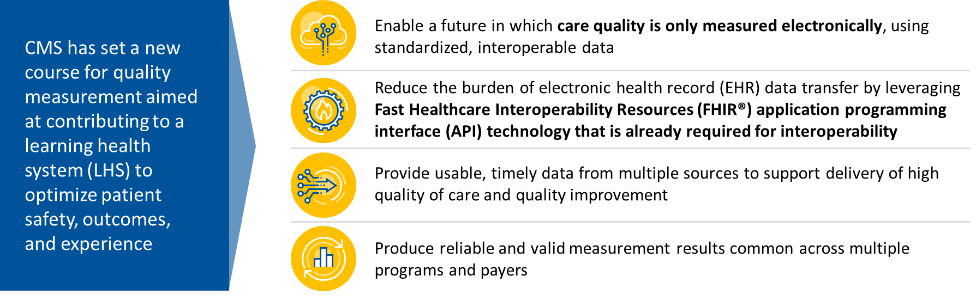
CMS has set the ambitious and critical goal of transitioning to digital quality measurement
CMS has set a new course for quality measurement aimed at contributing to a learning health system (LHS) to optimize patient safety, outcomes, and experience
Enable a future in which care quality is only measured electronically, using standardized interoperable data
Reduce the burden of electronic health record (EHR) data transfer by leveraging Fast Healthcare Interoperability Resources (FHIR®) application programming interface (API) technology that is already required for interoperability
Provide usable, timely data from multiple sources to support delivery of high quality of care and quality improvement
Produce reliable and valid measurement results common across multiple programs and payers
Notes:
CMS has committed to shifting to digital quality measurement (dQM) in its quality programs as a broad initiative, which requires CMS to begin planning the related requirements around how processes and systems need to change, what adjustments are expected for measures and the policies that underly quality measurement programs.

Slide 8
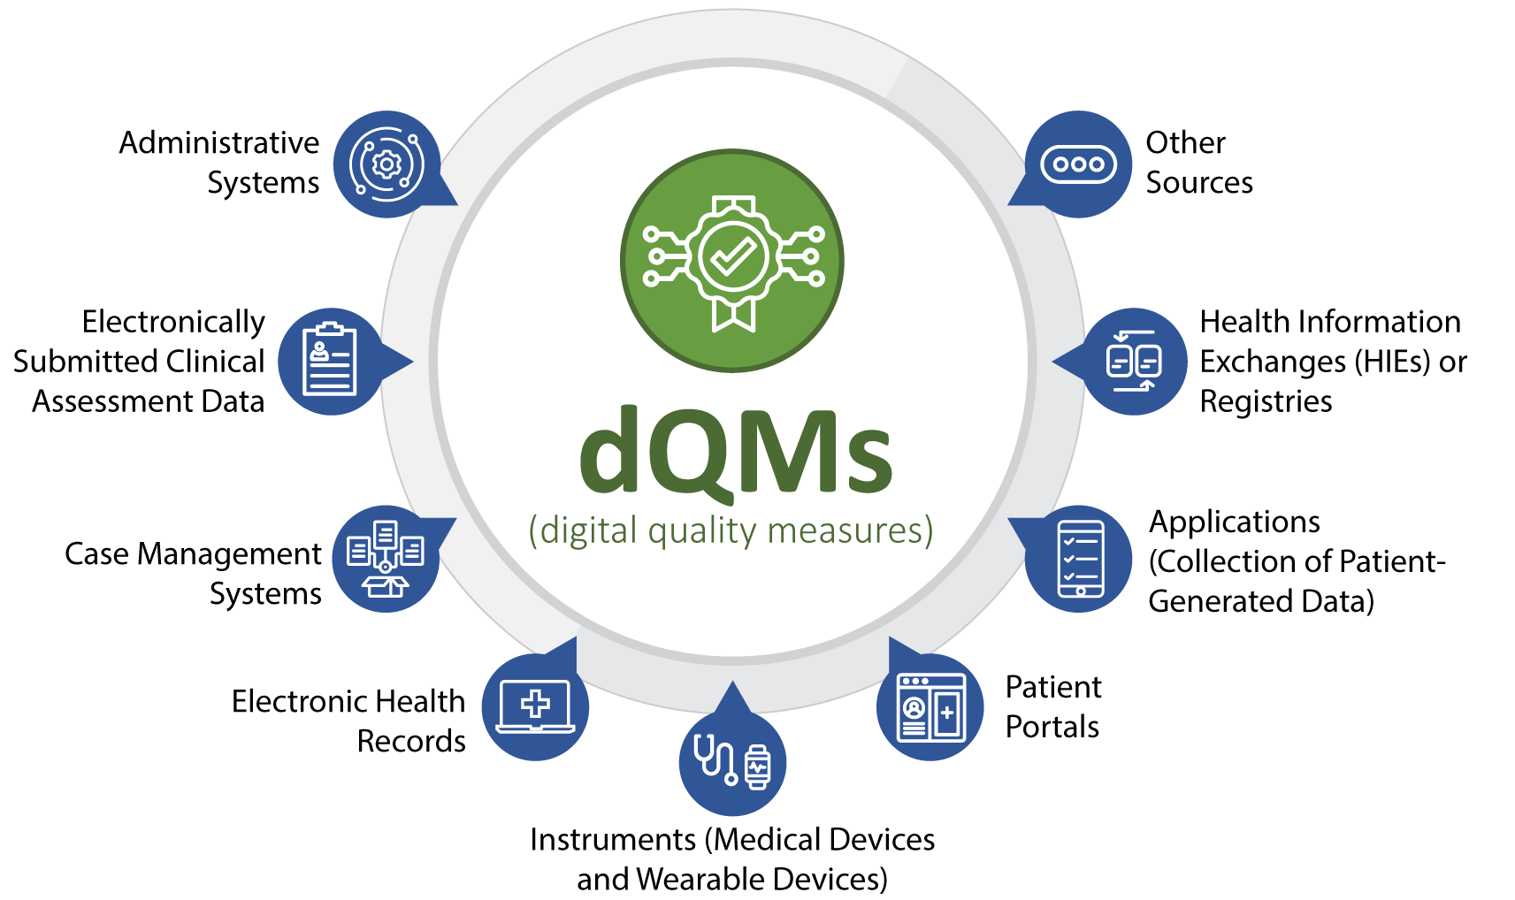
dQMs Defined
dQMs are quality measures, organized as self-contained measure specifications and code packages, that use one or more sources of health information that are captured and can be transmitted electronically via interoperable systems
Potential data sources for dQMs include EHR data, patient-generated health data, and registry data, among others
dQMs will leverage advances in technology (e.g., FHIR APIs) to access and electronically transmit interoperable data for dQMs
Notes:
The goal here is to collect data usable directly for dQMs, while minimizing the burden and effort required to make them suitable for that purpose.

Slide 9
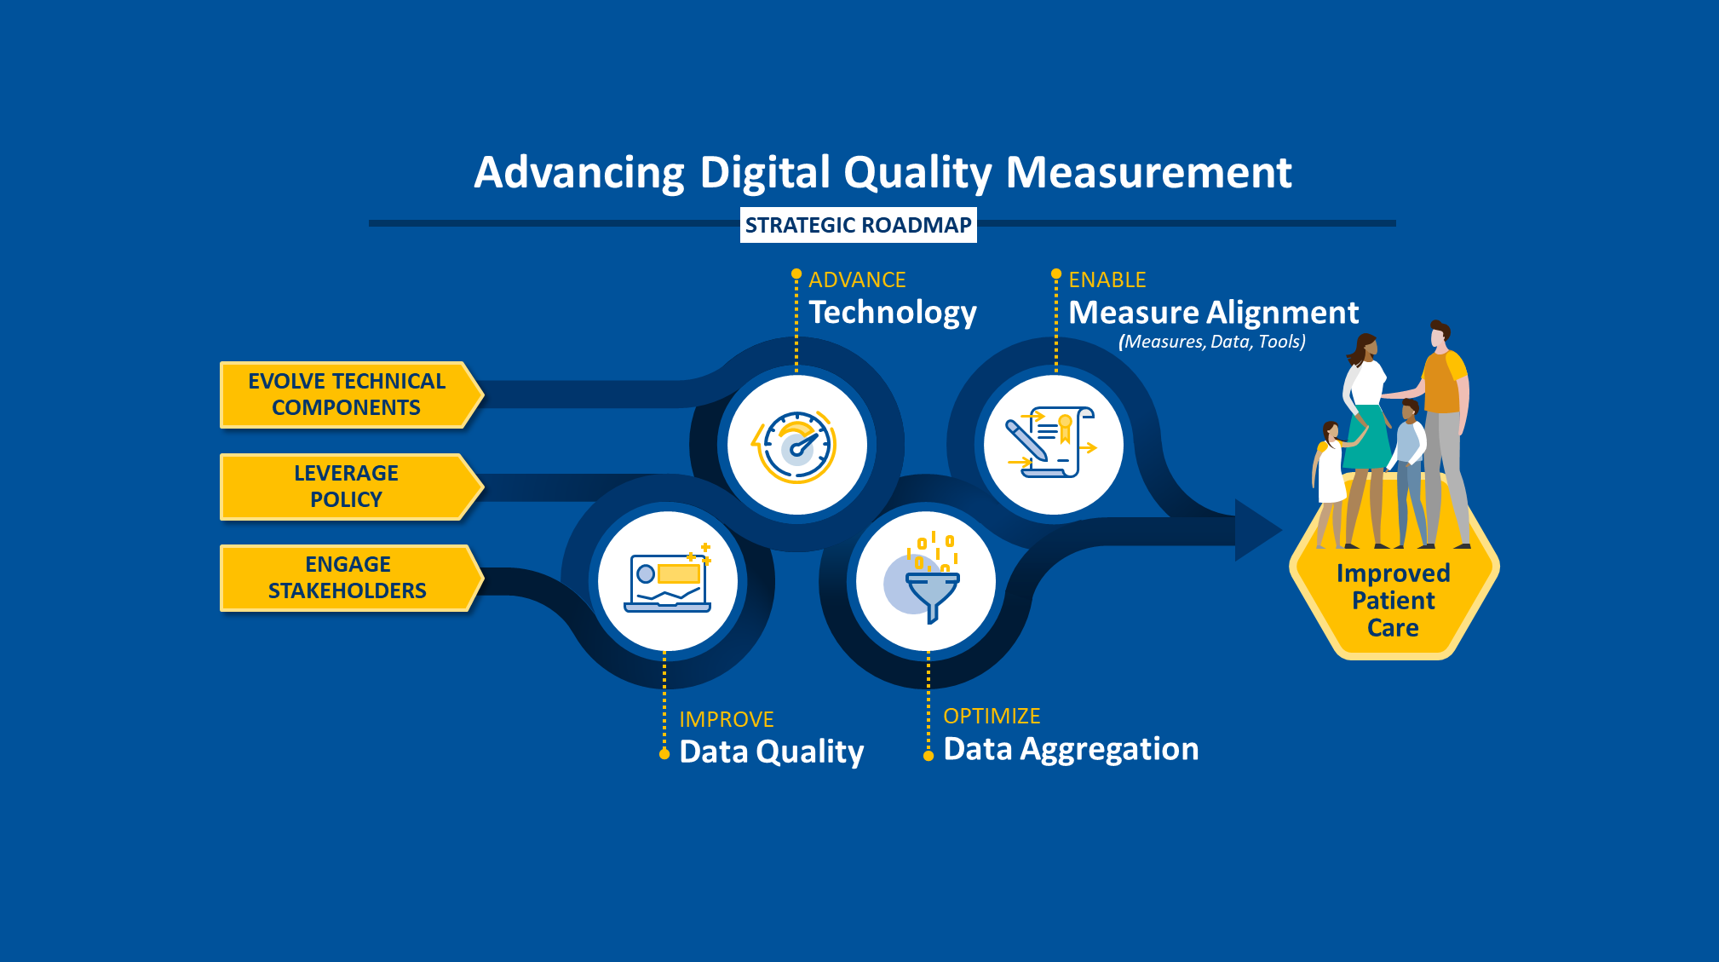
CMS developed a Strategic Roadmap for advancing digital quality measurement centered around four key domains
CMS Digital Quality Measurement Strategic Roadmap available at: https://ecqi.healthit.gov/sites/default/files/CMSdQMStrategicRoadmap_032822.pdf
Notes:
Opportunities to leverage advances in technology through FHIR standards/APIs for data transmission.
Opportunities to use existing datasets to aggregate a broader understanding of patient care and to serve multiple needs across the existing healthcare data systems.
Here we address how standards may be applied through existing program needs and aligning utilization — both at the data element and measure level — to support the capture/sharing/use of data across a broad variety of use cases including quality measurement thus fitting into a much broader project of interoperability within systems.

Slide 10
The dQM Strategic Roadmap aligns with the goals of
CMS’s National Healthcare Quality Strategy
National Healthcare Quality Strategy Goals
Embed quality across the care journey, must also extend quality across payer types
Advance health equity
Promote safety to prevent harm and death
Foster engagement with stakeholders with focus on person and family-centered care
Strengthen resiliency in the healthcare system
Embrace the digital age
Incentivize scientific innovation and technology
Increase alignment to promote seamless and coordinated care
https://www.cms.gov/Medicare/Quality-Initiatives-Patient-Assessment-Instruments/Value-Based-Programs/CMS-Quality-Strategy

Slide 11
CMS is participating in advancement of interoperability across the Agency and the enterprise
Strategy and Policy
Collaboration
Standards and Technical Components
Action
Application Program Interface (API) Strategy
Interoperability and Patient Access Final Rule (CMS-9115-F)
Interoperability and Prior Authorization Proposed Rule (CMS-9123-P)
CMS Digital Quality Measurement Strategic Roadmap
CMS Burden Reduction Executive Steering Committee
Interoperability and Standards Collaborative
Federal Health IT Coordinating Council
Standards Development and Advisory Organizations
Healthcare Providers, Plans, Beneficiaries, Vendors and Other Stakeholders
Assessment Data Element Library
eCQM Data Element Repository
United States Core Data for Interoperability (USCDI)
USCDI Plus Quality Measurement (QM)
Blue Button 2.0
Beneficiary Claims Data API
Data at the Point of Care
Documentation Requirements Look-up Service
Electronic Prior Authorization
Post-Acute Care Interoperability Project (PACIO)
Digital Quality Measurement: systems, tools, and measures
Notes:
CMS has a number of ongoing projects considering the advancement of interoperability. Digital quality measurement (dQM) is one which we see interacting with a number of efforts for data standardization through the USCDI and USCDI+ initiatives at ONC. Coordination with these other functions is key, since they create a set of use cases for the captured data that define the broad set of needs that data requirements should be meeting.

Slide 12
On digital quality measurement, CMS’s Center for Clinical Standards and Quality is actively advancing systems, tools, and measures
Action
Activities
Engaging with stakeholders on the dQM Strategic Roadmap rollout and planned modernization activities
Working with ONC to identify data elements for quality measurement to inform the USCDI and USCDI+ Quality Measurement (QM) datasets
Built and refining tools for specifying and testing eCQMs in FHIR®
Building a FHIR server infrastructure for quality data receipt and storage
Converting eCQM specifications from Quality Data Model (QDM) to FHIR
Coordinating standards definition through HL7®
PACIO Project to advance PAC assessment data interoperability
Blue Button 2.0
Beneficiary Claims Data API
Data at the Point of Care
Documentation Requirements Look-up Service
Electronic Prior Authorization
Post-Acute Care Interoperability Project (PACIO)
Digital Quality Measurement: systems, tools, and measures

Slide 13
Importance of Data Standardization

Slide 14
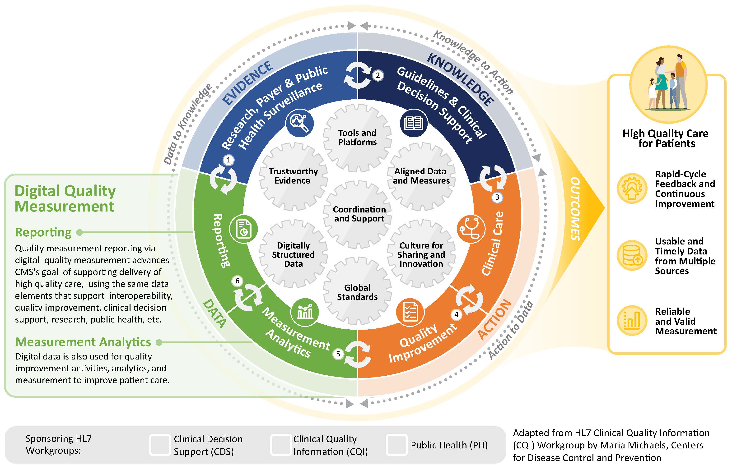
A learning health system uses data to drive health care
Notes:
An LHS is a healthcare data system which allows the capture of data at multiple points throughout the course of the health system to gather knowledge about patients and the care received, and the processes providing those care, and then use that knowledge as a recursive loop for system improvement. Quality measurement fits within that very importantly, because of the need for specified data requirements and the efforts towards standardization undertaken over the last several years.

Slide 15
Why data standardization?
CMS is contributing to the establishment of a functional learning health system, with standardized data as the foundation
  Learning health systems generate knowledge from data captured during routine care
Data standardization
  Transforms data into a common format
  Ensures data quality
  Allows for data flow
  Supports program alignment
Standardized data could be used for multiple use cases, such as
  Patient health data access
  Quality measurement
  Big data analytics
  Research
Notes:
By increasing the breadth of data standardization, this provides for data comparability that magnify your power of analysis through the use of silos in existing systems, frequently data captured multiple times but unable to flow point-to-point within the healthcare system. The goal here is to set up a system that obviates the need for extensive effort following the data collection process.

Slide 16

Structured, standardized data can lead to reduced collection and reporting burden
CURRENT STATE
FUTURE STATE
Providers’ struggle to implement current eCQMs
Limitations and slow adoption of current standards
Lack of provider data mapping and quality assurance of required data
Required changes to clinical workflows
dQM implementation is seamless and automated
Focus on standardized data – FHIR, United States Core Data for Interoperability (USCDI), and supplemental standards (i.e., USCDI+) that enable automated extraction of data
Standardized and automated data collection facilitates valid and reliable data mapping and streamlined auditing processes
Eliminate workflow changes required only for measurement and focus on measures that also align with quality improvement priorities
Notes:
Current State—Data is captured for a specific trick in the system/program and fit specific needs well, but data are captured only for that purpose. Also, their utility is either limited, nonexistent or shoehorned into a set of needs.
Future State—Used for research and development of clinical guidelines, and the assessment of the provision of clinical care. The standardization of data allows for the development of common tools for assessing the validity and reliability of data, and the mapping of existing data to a standard. It allows us to modify/reduce the amount of workflow created by the need to capture data at multiple points in a repetitive fashion for different programs.
Administrative costs— Data collection is excessive within the American healthcare system. We require a better methodology without exacerbating the administrative burden that exists independent of care provided to patients, which is at the crux of this project.

Slide 17
Why the FHIR standard?
Reduces burden
  Align CMS eCQM reporting with industry clinical data exchange framework and CDS
  Data exposed in a consistent format enables automated data retrieval from EHRs and submission of quality data through use of standards-based APIs
  Enable the provision of near real-time feedback on quality measurement results to providers
Simplifies data mapping
  Single mapping to FHIR vs. mapping to Health Quality Measure Format and Quality Reporting Document Architecture
Promotes interoperability
  Aligns data exchange requirements for quality measurement and reporting with interoperability standards used in other healthcare exchange methods
  Flexibility of the standard allows access to and exchange of information; suitable for use in a variety of contexts
  FHIR is also being embraced by the commercial community and big tech

Slide 18
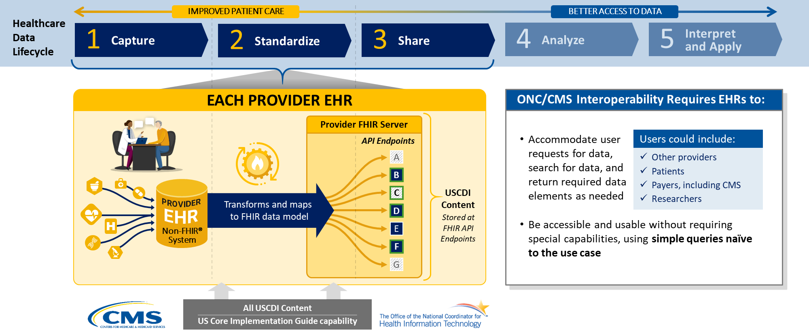
Many providers already have to implement FHIR APIs that perform transformation functions for data interoperability
Notes:
By taking existing data systems and mapping them within the EHR to a set of predefined API endpoints or data elements that can then be exposed to queries from APIs, including those that support CMS quality reporting allows EHRs to support the QRPs. Once those API end points are exposed, if they’ve been standardized in other programs from private/public payors at the state/federal level, if they have aligned their business needs, they can access those data without requiring a novel set of requirements on the part of the EHR. Those data are accessible/usable across those use cases and not limited to meeting CMS’ quality reporting requirements.

Slide 19
Current CMS Activities to Advance Digital Quality Measurement

Slide 20
CMS is committed to advancing data standardization and collaborating across the industry
Authoring eCQMs in FHIR as an initial step in the digital quality measurement transformation
Collaborating with ONC to support advancing data for digital quality measurement and other uses cases through data standardization
  Engaging in the USCDI process, developed by ONC to identify a standardized set of health data classes and constituent data elements
  Engaging with ONC on the USCDI+ initiative, to advance standardization of additional data elements for quality measurement
Harmonizing across federal agencies to ensure CMS data element needs and standards for quality measurement align with other use cases (e.g., public health, quality improvement, clinical decision support)
Engaging with Health Level Seven International (HL7) and other standards-setting body processes to continue to advance FHIR resources
Engaging stakeholders throughout the dQM transition

Slide 21
1. Authoring eCQMs in FHIR as an initial step in the digital quality measurement transformation
eCQMs are one subset of dQMs
CMS is converting current QDM-eCQMs to FHIR-eCQMs
The implementation of future FHIR eCQM reporting will serve as a model for future dQM reporting
  Will show utility and feasibility of standard-based reporting
  Advancing data standardization and FHIR standards are critical for CMS eCQM reporting
The transition work requires CMS to set up systems and tooling that would first be used for FHIR eCQMs, then could be used for future dQMs
  We are considering the development of a unified CMS FHIR receiving system that would allow for a singular point of data receipt to be used for quality reporting requirements, and leverage opportunities related to digital data
Notes:
The goal ultimately is to achieve digital quality measurement across our programs. CMS is working with measure developers to plan out the conversion of QDM-based measures to the FHIR standard, while also developing tools analogous to MAT and Bonnie. That model is selected in the development of eCQMs to allow quality measures from other data sources, including Medicare claims, BHSN, CAHPS and others.

Slide 22
2. Engaging in the ONC USCDI processes
ONC’s USCDI
  Comprises a core set of data needed to support patient care and facilitate patient access using health IT
  Establishes a consistent baseline of harmonized data elements that can be broadly reused across use cases, including those outside of patient care and patient access
  Expands incrementally over time via a transparent, established, and collaborative processes, weighing both anticipated benefits and industry-wide impacts
Example priority Data Classes identified by CMS to date, for quality measurement and patient care
  Encounter information
  Medication
  Laboratory
  Vital signs
  Health insurance information
  Observations, including questionnaires
  Facility level data (identifiers)
  Medical device or equipment
  Orders
https://www.healthit.gov/isa/united-states-core-data-interoperability-uscdi
Notes:
ONC’s USCDI Version 3.0 incorporates the data classes and data elements as part of the requirements for certified health IT. There are regulatory steps that must be taken, but in the interim this defines new standards for data classes as being core to the health IT infrastructure and vital to capturing patient health information.
The data classes are imperative, not only for key clinical concepts to be captured, but also to ensure that the contextual data about when patients are seen, who they’re being treated by, who they’re being seen by, when they’re being seen — that all of this information is vital to using the clinical information as it transfers from one location to another. Lastly, it means that data are useful for purposes outside of its original intent, which speaks volumes to the concept of interoperability.

Slide 23
2. Gathering requirements for USCDI+ QM
USCDI+ provides a pathway to develop nationally-recognized data sets that advance program goals via interoperability, while remaining harmonized across programs/use cases
USCDI+ QM requirements-gathering activities supports identifying a comprehensive data set of elements for quality measurement, building on the USCDI
  USCDI+ QM would be the data set of elements for quality measurement
  The data elements would be used initially for eCQM reporting using FHIR and in the future, for additional dQMs
To support USCDI+ discovery process, CMS launched an exercise to compile data elements in FHIR standards
  Has created an inventory of data elements used for CMS eCQMs
  Invited federal partners with quality measures to join in and identify commonly used data elements
Notes:
There was engagement with ONC early in this process for a USCDI+ quality measurement domain, the purpose being to identify data elements that may not necessarily fit within the core USCDI, but are still relevant to quality measurement initiatives at CMS.
The goal is a repository where identified data element standards are applied to quality measures or related use cases without recreating standards/competing standards that undercut the utility of interoperability. It essentially creates a location for the identification of relevant data for quality measurement and then agree upon in a systematic way how those data are captured across the healthcare system.

Slide 24
3. Harmonizing and aligning across federal agencies
Goals for aligning data elements across federal agency quality measurement programs currently underway
  Began with list of CMS quality measurement needs and priority data elements
  Obtain input from federal partners to identify additional data needs that may not fit within the USCDI
  Achieve consensus on prioritization of data needs, which can serve as a signal to ONC
CMS is also closely collaborating with the Centers for Disease Control and Prevention to align the public health and quality measurement use cases, where possible, including data elements, implementation guides, and tooling/reporting architectures
Notes:
Quality measurement is not limited just to CMS. By harmonizing the data elements being collected, we can calculate analogous measure results in different systems that are comparable, and potentially reconfigure those data elements to meet program or business-specific needs and therefore the data are more flexible.
In addition to working with ONC, CMS is talking with other federal agencies. We expect that there will be overlapping data elements. If they’re utilized in other use cases, we’d expect to see that same standardization across them, so that the data elements as they’re defined within USCDI+ are still usable.

Slide 25
4. Engaging with HL7 processes to continue to advance FHIR resources
To advance implementation of standardized data, collaboration with consensus standards-setting bodies such as HL7 is critical
We are considering how best to leverage existing implementation guides that are routinely updated and maintained by HL7 to define data standards and exchange mechanisms for FHIR dQMs in a fashion that supports the learning health system and alignment across use cases
We are also considering what, if any, additional CMS-specific implementation guides may be necessary to support future digital quality measurement, such as guidance on aggregation mechanisms for reporting
Notes:
SDOH is an example where efforts such as the Gravity Project have been pursuing new data elements to capture information about patients and help to provide context about the care that is needed, the care that is received, and the access to resources that affect the patient care process, but also potentially be supported by the provision of better care and accountability within the healthcare system.

Slide 26
5. Engaging with stakeholders on digital quality measurement transition plans
CMS released a Request for Information (RFI) related to advancing digital quality measurement through the use of FHIR in the Fiscal Year (FY) 2023 IPPS Proposed Rule; content included:
  Refined Potential Future Definition of Digital Quality Measures (dQMs)
    Requested feedback on the potential refined definition of digital quality measures and considerations related to use of non-EHR data sources
  Data Standardization Activities
    Outlined data standardization strategies and potential venues for advancing data standardization
    Requested feedback on the specific implementation guides being considered and other data and reporting components where standardization should be considered
  Approaches to Achieve FHIR eCQM Reporting
    Outlined activities CMS is undertaking or considering to achieve FHIR eCQM reporting
    Requested feedback on additional venues to engage with implementors, data flow opportunities, and any other critical considerations during the transition
Notes:
It is clear CMS requires support from the broader provider community in implementing data standardization within systems which involve a commitment to interoperability. CMS is engaged with external and internal federal stakeholders on data standardization activities, while encouraging individuals to participate in the HL7 process for advancing standards and seeking feedback on Implementation Guides (IGs) and lastly, reminding individuals of the opportunity to participate in ONC’s USCDI efforts to identify relevant core data elements.

Slide 27
5. Engaging with stakeholders: FY 2023 IPPS Rule RFI Feedback Summary
CMS received feedback from stakeholders on the RFI, related to the following topics:
General feedback on transition to digital quality measurement
  Widespread support among commenters for CMS’s efforts to transition to digital quality measurement
  Support for leveraging the FHIR standard and FHIR APIs, though some commenters noted the standards and implementation guides are still maturing and others suggested flexibility in standards requirements
  Request for ample time for the transition and information on transition plans
  Recognition of burden and cost associated with the transition
Regarding the potential refined dQM definition and use of non-EHR data sources
  Support for the definition capturing broad range of evolving healthcare information sources
  Some concern the definition is too broad to be meaningful and requests for additional examples
  Request for further clarification of eCQMs compared with dQMs
  Support for use of non-EHR data sources in dQMs to enhance completeness of data used for quality measurement
  Concern for current lack of standardization and requirements for non-EHR data sources, and lack of access by clinicians to information from these data sources
Notes:
There is continued feedback related to the transition to dQM, with clear support to shift to digital quality measurement as well as hesitation around the potential timeline, and the desire to ensure that CMS is mindful of the efforts necessary to implement FHIR standards and reporting based on APIs.
There are requests to ensure enough time for implementation, and a push to recognize that the transition itself is not a trivial one and involves the application of a fair amount of resources. The next stage of advancing the implementation of FHIR is moving beyond eCQMs to other data sources, though currently the majority of efforts are focused on eCQMs specifically.

Slide 28
5. Engaging with stakeholders: FY 2023 IPPS Rule RFI Feedback Summary, cont.
Regarding data standardization activities
  Support for the implementation guides CMS is considering using for dQM, including the Quality Improvement Core and the Data Exchange for Quality Measures (DEQM) Implementation Guides, and recommendations for additional implementation guides to consider
  Support for alignment with ONC’s USCDI and future USCDI+ QM
  Recommendations to continue testing and validating implementation guides, with opportunity for stakeholder input, to ensure maturity of implementation guides and alignment across guides
  Recognition of need for guidance related to data exchange methods, aggregation activities, and implementation of content
Regarding approaches to achieving FHIR eCQM reporting
  On venues to engage with implementors and other stakeholders:
    Recommendation to continue Connectathons, and solicit input from groups including NQF, EHR Association, Health IT developers, HIEs, and hospitals and clinicians
    Suggestions that CMS conduct sufficient large-scale testing and consult with multi-stakeholder groups prior to wide-spread adoption
  On data flow options:
    Support for clinical quality language, FHIR, and FHIR-based APIs, but concerns expressed regarding security and privacy considerations
    Identification of the need for data quality and validity assurances
    Suggestions to explore additional API functionality requirements (for example subscriptions or Bulk FHIR) and consider associated costs
    Recognition of benefit of real-time data exchange and rapid feedback loops

Slide 29
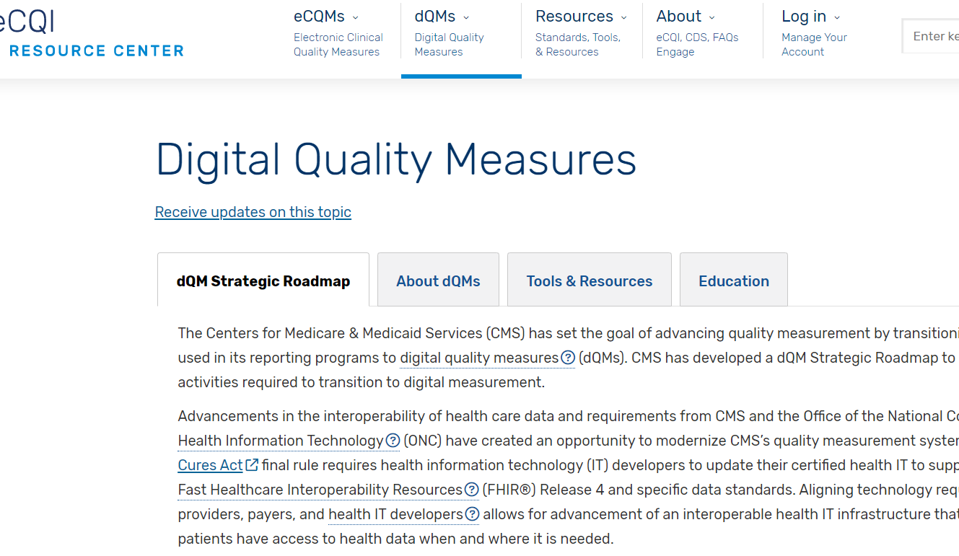
5. Engaging with stakeholders: dQM Webpage
CMS launched a Digital Quality Measures webpage on the Electronic Clinical Quality Improvement (eCQI) Resource Center to engage stakeholders
  Goal:
    Provide a location for stakeholders to access information and materials related to CMS’s plans
    and activities to move toward full digital quality measurement
  Current Content:
    dQM Strategic Roadmap Overview
    CMS dQM Strategic Roadmap Report and Executive Slide Deck
    Discussion of dQMs and learning health systems
    Links to related initiatives
    Education resources
https://ecqi.healthit.gov/dqm
Notes:
Earlier this year CMS published the dQM page on the eCQI Resource Center. The URL is provided above. It provides some baseline information about the approach and the roadmap itself, along with details about the non-data standardization arenas under consideration for implementation. Also provided are links to other resources and tools. We anticipate updates as we proceed down the path of the roadmap in the coming months and years.

Slide 30
Looking Ahead

Slide 31
Standardized data used for quality measurement as part of a learning health system is critical for high quality care for patients
Notes:
This circles back nicely to the concept of a learning health system (LHS). As we build out requirements and processes, we strive for seamless interplay in an environment where interoperability is being pursued elsewhere, this being integral to aligning with other federal organizations, and ultimately requiring a conversation with private organizations as well.

Slide 32
Standardized data is the foundation for alignment across measures, data sets, and tools
CURRENT STATE
FUTURE STATE
Program-, payer-, and setting-specific
Strides toward interoperability
Providers must support many measures
Measures create burden for the provider
Data are fragmented across capture systems, thereby limiting the feasibility of measures that capture the full patient course
Common dQM portfolio across payers and agencies
  Aligned measures
  Consistent data
Data resources, standards, measures, and tools are shared across the healthcare ecosystem
Reporting across payers is low burden
Health system learning is coordinated and shared, and promotes rapid-cycle feedback
Notes:
As the tools to make use of those data change, we expect a need for an infrastructure to manage for continued alignment, continued implementation of new data requirements, and also to ensure that a broad base of data needs are represented within these standards and requirements that support and underly the learning health system (LHS). Therefore, there needs to be broad-based engagement not only among federal organizations, but also among private, state and other stakeholders.

Slide 33
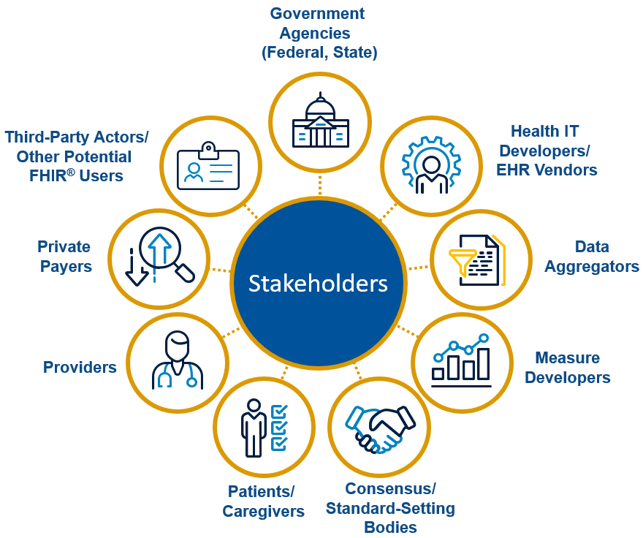
CMS’s active engagement with a broad set of stakeholders is critical for success
Engagement is critical for the success of forming, operationalizing, and maintaining the dQM Strategic Roadmap to facilitate dQM transition activities
Harmonization and alignment of priorities for digital data are necessary and incremental
Notes:
CMS is working to identify different parties we believe are relevant throughout this process. Some are already involved in digital quality measurement (dQM), while others may make use of the data but do so for purposes not directly related to CMS programs. We therefore are reaching out to areas within CMS and ONC with broader-based experience talking with these organizations to gather input and to join the conversation on these issues.

Slide 34

How to Get or Stay Engaged
Become familiar with CMS’s Digital Quality Measurement webpage on the eCQI Resource Center
Look out for opportunities to provide feedback on FHIR-based measure specifications prior to implementation, such as during measure development/conversion activities
Provide continued feedback on RFIs and any future proposals through CMS’s rulemaking processes
Participate in ONC’s USCDI processes and provide feedback
on high priority data elements for inclusion
Participate in HL7 and CMS/HL7 Connectathon testing
Look out for opportunities for collaboration via systems testing of FHIR-based eCQM reporting to ensure successful systems development

Slide 35
Questions?
Joel Andress
joel.andress@cms.hhs.gov
https://ecqi.healthit.gov/dqm

Slide 36
Get Connected
Want to learn more?
Sign up to receive email updates from MMS, including the monthly MMS Bulletin that features clinical quality measurement announcements, events, and opportunities to get involved.
https://public.govdelivery.com/accounts/USCMS/subscriber/new

Slide 37
CMS
Melissa Gross (CMS Lead)
Contact: Melissa.Gross@cms.hhs.gov
Battelle
Contact: MMSSupport@battelle.org

