Slide 1

Measure Testing Problems and Solutions
A testing topic roundup
Laura Aume, Battelle
Kathy Lesh, Battelle
Sam Simon, Mathematica
July 27, 2022

Slide 2
Background
We will focus on a handful of specific testing-related topics that emerged from this year’s Measures Under Consideration (MUC) List submission process and interactions with measure developers.
  These topics will not address all commonly encountered testing problems
If there are other testing questions you would like discussed during a future session, we encourage you to email us at MMSsupport@battelle.org

Slide 3
Goals of Session
To learn about potential solutions to the following measure testing challenges:
  Which intraclass correlation coefficient (ICC) variation is most appropriate to assess reliability?
  What is person/encounter level data?
  Are there standardized ways to evaluate quality measure feasibility?

Slide 4

Intraclass Correlation Coefficient

Slide 5
Reliability
Reliability testing evaluates whether:
  The measure data elements are extracted over time, produce the same results a high proportion of the time when assessed in the same population in the same time period, and/or that
  The measure score is precise.
Reliability also applies to abstractors and coders (e.g., inter-rater reliability [IRR]).
It can also refer to the amount of error associated with the computed measure scores (e.g., signal vs. noise).
Source: MMS Blueprint Measure Lifecycle. MMShub.cms.gov. Updated: May 2022. https://mmshub.cms.gov/measure-lifecycle/measure-testing/evaluation-criteria/scientific-acceptability/reliability. Accessed July 7, 2022.
Notes:
In reliability testing precision can be representative if you had a confidence interval around a score. If that confidence interval is extremely wide, then the measure is too wide to be practical and therefore the measure score isn’t very precise. Another application of reliability would be for IRR which tests the consistency between raters like abstractors and coders. Reliability refers to an error associated with a measure, for example, signal vs. noise or the measure error divided by the total error of a measure.

Slide 6
Evaluating Reliability
Reliability values range from 0 to 1
  Values closer to 1 represent stronger reliability.
  Mathematically, reliability is the ratio of true variance over true variance plus error variance.
Intraclass correlation coefficient (ICC) is a measure of reliability that reflects both degree of correlation and agreement between measurements, offering an advantage over historical methods (e.g., Pearson correlation coefficient)
Source: Koo, TK, Li, MY. A Guideline of Selecting and Reporting Intraclass Correlation Coefficients for Reliability Research. J. Chiropr. Med. 2016;15,155-163. https://www.ncbi.nlm.nih.gov/pmc/articles/PMC4913118/pdf/main.pdf. Accessed July 7, 2022.
Notes:
Reliability values range from 0-1—Values closer to “1” are ideal since they promote the chance of a very strong measure of reliability. The reliability is the measure of the true variance of the measure over the variance plus the other error attributed, for example, to the sample size.
Intraclass correlation coefficient—Reflects better correlation agreement between measures than historical methods such as the Pearson correlation coefficient, since it incorporates a rater bias not available in a Pearson correlation coefficient. One rater may present a different but consistently higher rating than another and still deliver a strong correlation coefficient, but the ICC adjusts here.

Slide 7
Using the Intraclass Correlation Coefficient
Different types of reliability can be assessed with ICC.
  Inter-rater – the extent two observers agree on the same phenomenon.
  Intra-rater – extent of consistency of one observer.
  Test-retest – extent a survey/instrument provides same response under the same conditions.
There are multiple variations of ICC, that can give different results when applied to the same set of data:
  How do you know which variation of the ICC to use?

Slide 8
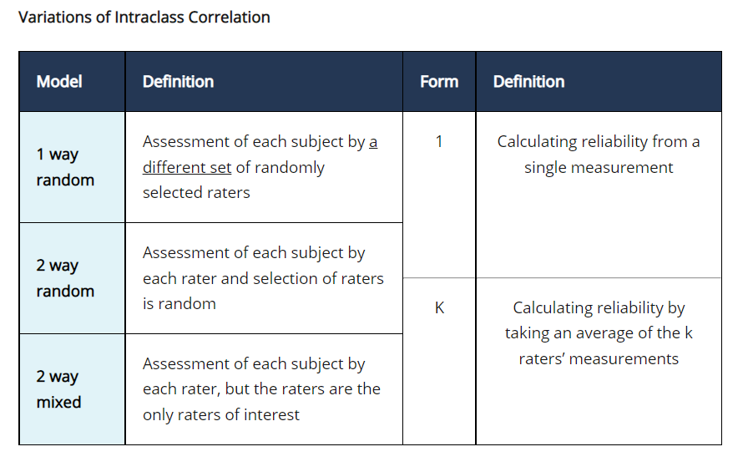
Intraclass Correlation Coefficient Variations
The variation selected depends on the:
  model (random or mixed effects)
  form (number of raters; single or k)
  the type of reliability of interest (agreement or consistency in ratings)
Source: MMS Blueprint Measure Lifecycle. MMShub.cms.gov. Updated: May 2022. https://mmshub.cms.gov/measure-lifecycle/measure-testing/evaluation-criteria/scientific-acceptability/reliability. Accessed July 7, 2022.
Notes:
1 way random—A model that has one measurement per subject, and each subject may be measured by a different rater. There is not a way to compare raters and thus only compares the different subjects to derive an estimate of the measure consistency.
2 way random—A subject is one of the factors, along with the raters for which there are multiple raters per subject. Each subject is measured by multiple raters, and each rater rates each subject, but raters are a random effect meaning they are drawn from a population of similar raters.
2 way mixed— A subtle difference is that each rater is a specific rater of interest, and there are different ways of calculating the ICC. The Koa and Li paper gives more detail about how each ICC is calculated to each particular case.

Slide 9
Signal-to-Noise
Another way to assess measure score reliability is to calculate the signal-to-noise ratio (e.g., Adams, 2009) which estimates the proportion of variability in measured performance that can be explained by the real differences in performance between measured entities.
The relationship between signal-to-noise and ICC and why reliability results may differ between the two is unclear
  Efforts to clarify the relationship between the two statistics are underway
Source: Adams, JL (2009). The Reliability of Provider Profiling: A Tutorial. Santa Monica, CA: RAND Corporation.
Notes:
There are multiple cases where an ICC or the signal-to-noise are both calculated and arrive at different results. Battelle is currently working on assessments to determine those results and their accompanying relationships, and so those efforts are underway to clarify the relationship between those two statistics.

Slide 10

Data Element Terminology

Slide 11
Data Element Definitions
Data Element – A data element is a single piece of information used in quality measures to describe part of the clinical care process
  Individual data elements are combined to produce a measure score
Data Element Validity – extent to which the information represented by the data element reflects the actual concept intended.
Data Element Reliability – assesses the repeatability/ reproducibility of the data element.
  Often not tested if data are produced electronically, in an automated fashion
Sources: MMS Blueprint Measure Lifecycle. MMShub.cms.gov. Updated: May 2022. Accessed July 7, 2022. https://mmshub.cms.gov/measure-lifecycle/measure-testing/evaluation-criteria/scientific-acceptability/validity.
Geppert, JJ, Rabel, B. CMS Measures Management System (MMS) Testing Scientific Acceptability for de novo eCQMs. Oral presentation for CMS MMS Information Session; July 26, 2018. Accessed July 6, 2022. https://www.cms.gov/Medicare/Quality-Initiatives-Patient-Assessment-Instruments/MMS/Downloads/CMS-MMS-Webinar-BP101-%E2%80%93-Scientific-Acceptability-of-eCQMs.pptx.
Notes:
A data element is the building block of quality measures. Quality measures are comprised of the numerator, denominator and exclusions and exceptions. Every measure’s data element consists of specific codes for either encounters, patient characteristics, devices applied/ordered, diagnoses, medications, symptoms, lab tests and interventions.
HIV measure CMS 349:
The description of the measure is the percentage of patients 15-65 tested for HIV.
The denominator component, the data element would be a patient characteristic, in this case “age.”
The numerator component, the primary data element here is the laboratory test; therefore, seeking a code indicating an HIV test was administered.
The HIV measure has an exclusion, and therefore the data element would be the diagnosis of HIV.
In summary—Each measure component, each numerator, denominator and exclusion is made up of one or more data elements. In reference to validity we address the accuracy of the data elements. Reliability for data elements refers to the reproducibility of results. For eCQMs data elements in an EHR pull the same codes with benefits of a single definition for the data element. For example, a diagnosis will always be presented consistently so that reliability becomes less of an issue for data elements from eCQMs.

Slide 12
Data Element vs. Person/Encounter Level
The measure development community is working to identify more precise terminology for the components that contribute to a measure score.
CMS’s Consensus Based Entity (CBE), currently National Quality Forum, recently updated its terminology.
“Person or encounter level testing” is the new terminology for data element testing.
  For 2022 MUC List submissions, CMS MERIT refers to patient/encounter level testing of the individual data elements.
  Person/patient or encounter level data ≠ patient-reported data
Source: Measure Developer Guidebook for Submitting Measures to NQF. National Quality Forum. August 2021. https://www.qualityforum.org/WorkArea/linkit.aspx?LinkIdentifier=id&ItemID=86083. Accessed July 7, 2022.
Notes:
Data element testing is now referred to as person/encounter level testing by NQF. References to person/encounter level testing should make you think about data elements, which is in contrast to testing at the measured entity level typically being the clinician, clinician group, hospital, nursing home, etc.

Slide 13
Critical Person/Encounter Level Elements
All critical person/encounter level elements (i.e., data elements) should be included in testing.
  These include the numerator, denominator, and exclusions; any elements that are used in calculating the measure score
Source: Measure Developer Guidebook for Submitting Measures to NQF. National Quality Forum. August 2021. https://www.qualityforum.org/WorkArea/linkit.aspx?LinkIdentifier=id&ItemID=86083. Accessed July 7, 2022.
Notes:
What do critical data elements mean?
To demonstrate that a measure is valid, all clinical data elements should be tested for validity. A notable exception is encounter codes, but all other data elements such as patient characteristics, devices applied or ordered, diagnoses, medications, symptoms, lab tests, interventions — all are validated. The most accepted approach to test a data element or critical person/encounter level data elements is to compare the data element to a gold standard and evaluate the agreement between the measure data element and that source of truth.
For eCQMs this is done by randomly selecting a sample of patients and comparing data elements electronically extracted from an EHR that’s a manual chart abstract that uses the entire EHR. The structured EHR fields may/may not be an accurate representation of care. The manual abstraction will pick up the embedded data in non-discrete/nonstructured fields such as physician or nurse notes.
So in looking at agreement, the preferred statistic to use between the extract and the chart abstract is to look at CAPA, which adjusts for chance agreement. In addition to CAPA, sensitivity, specificity, positive predictive and negative predictive values are useful in generating mismatches.

Slide 14

Assessing Feasibility

Slide 15
Feasibility Definition
Feasibility is the extent to which the specifications, including measure logic, require data that are readily available or easily captured without undue burden and implemented for performance measurement.
Feasibility is important to assess because a measure can only be used by organizations if they have the data needed to report the measure.
  For a measure to be widely implemented its data elements must be relatively easily collected.
Source: MMS Blueprint Measure Lifecycle. MMShub.cms.gov. Updated: May 2022. https://mmshub.cms.gov/measure-lifecycle/measure-testing/evaluation-criteria/feasibility. Accessed July 7, 2022.
Notes:
All measures must have feasibility checks, and the earlier in measure development the better. It also is not a “once and done,” since you continually check for feasibility throughout the measure development and maintenance process.

Slide 16
Feasibility Assessments
Should address
  Availability of data
  Extent of missing data, measure susceptibility to inaccuracies, and the ability to audit data to detect problems
  Estimates of the costs or burden of data collection, data entry, and analysis
  Barriers encountered in implementing quality measure specifications, data abstraction, measure calculation, or performance reporting
  Ability to collect information without violation of patient confidentiality
  Identification of unintended consequences
Source: MMS Blueprint Measure Lifecycle. MMShub.cms.gov. Updated: May 2022. https://mmshub.cms.gov/measure-lifecycle/measure-testing/evaluation-criteria/feasibility. Accessed July 7, 2022.
Notes:
Since most hospitals and clinicians are using EHRs, you must look at the data collected there. The feasibility assessment should address these items — availability, extent of missing data, cost burden of data collection, and barriers without violating patient confidentiality and identification of unintended consequences.

Slide 17
eCQM Feasibility Scorecard
The CMS CBE (NQF) created an eCQM feasibility scorecard assessing
  Data availability, is the data readily available in a structured format, i.e., resides in fixed fields in EHR?
  Data accuracy, what is the accuracy of the data element in EHRs under normal operating conditions? Are the data source and recorder specified?
  Data standards, is the data element coded using a nationally accepted terminology standard?
  Workflow, is the data captured during the course of care? And how does it impact workflow for the user?
Source: NQF eCQM Scorecard. https://www.qualityforum.org/WorkArea/linkit.aspx?LinkIdentifier=id&ItemID=89036. Accessed July 6, 2022

Slide 18
Assessing Quality Measure Feasibility
Currently there is not a general quality measure feasibility scorecard
Measure developers may consider modifying the eCQM scorecard for non-EHR-based elements
  Concerns about data availability, accuracy, standards, and workflow still apply!
Notes:
Given the push towards digital measures, the likelihood of a new chart-abstracted measure is unlikely. Consider the latest draft of a digital measure, which is to use sources of health information captured and transmitted electronically via interoperable systems.
Examples they provide are administrative systems, electronically submitted clinical assessment data, case management systems, EHRs, laboratory systems, prescription drug monitoring programs, medical devices, wearable devices and patient-generated data such as home blood pressure monitor or blood glucose monitoring, Health Information Exchanges and registries.

Slide 19
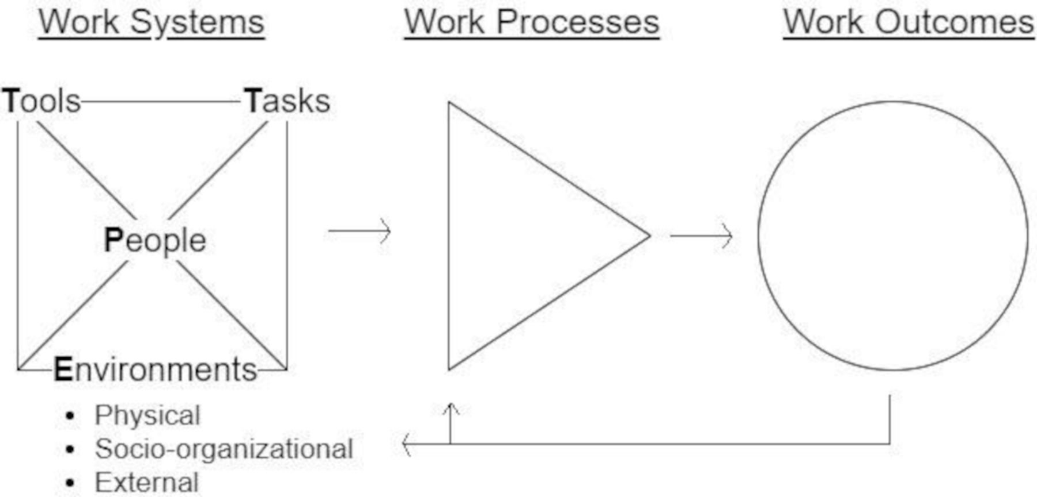
Frameworks to Assess Feasibility
Example question: Are procedure reports and pathology reports easily accessible?
Other frameworks can guide feasibility assessments
  For example, the SEIPS (Systems Engineering Initiative for Patient Safety) Model presents a theoretical framework to study and improve healthcare
  Feasibility assessment interviews can systematically evaluate potential workstream issues related to documentation needed for the measure or measure implementation
Example question: Who is necessary to implement the measure within your health system? What are the barriers to identifying or engaging these people?
Source: Holden RJ, Carayon P. SEIPS 101 and seven simple SEIPS tools. BMJ Qual Saf. 2021;30:901–910. doi:10.1136/bmjqs-2020-012538. Accessed July 7, 2022.
Notes:
SEIPS Model—Another method for testing feasibility is a model of human factors and ergonomics developed by Pascale Carayon and colleagues. It was first published in 2006 and its basis is in a work balance model and the Donabedian structure-process-outcome model. It has been used to understand or design sociotechnical systems and has supported evaluation, planning and research activities.
John M. Eisenberg Award—Dr. Carayon was awarded this award in 2015 for her individual achievement and excellence in promoting patient safety and quality care with the SEIPS Model. This award is a joint award given by joint commission and NQF annually and is given in the areas of individual achievement, national-level innovation and local-level innovation.
PETT scan—People are the individuals or groups of people and their physical, cognitive and psychosocial characteristics. Environments are settings of activities internal to the unit of analysis, or the surrounding external context and the characteristics and influences of these environments. Tools are objects of varying technical advancement used to transform and input into an output, and the characteristics of these tools, technologies, devices and artifacts which gets into usability. Tasks are specific activities assigned or performed within a broader work process and the sequence and characteristics of those tasks.
The PETT scan looks at interactions between the factor-to-factor combinations and ways factors interact, such as how well a tool fits a task or how the social environment affects a person’s behavior. The scan delves deeper as to a workflow may vary from person to person, or professional type to professional type. PETT also addresses barriers, and tools could be data availability and so forth. Lastly, the eCQM scorecard and the PETT scan of the SEIPS Model are only two possible tools that can help assess feasibility.

Slide 20
Discussion Questions

Slide 21

Upcoming Public Webinars

Slide 22
CMS
Melissa Gross (CMS Lead)
Contact: Melissa.Gross@cms.hhs.gov
Battelle
Contact: MMSSupport@battelle.org

